Slide 1



Aims:
Build on and embed the physical development and skills learned at KS2.
Become more competent, confident and expert in their skills and apply them across different sports and physical activities.
Understand what makes a performance effective and how to apply these principles to their own
and others’ work.
Develop confidence and interest to get involved in exercise, sport and activities out of school and in later life.
Understand and apply the long-term health benefits of physical activity.
Core Physical Education
Key Stage 3
Engage, inspire, lead
Skill Development to succeed
Students develop and refine specific skills in a variety of sports
Through a range of team and individual sports
Year
7
Theory underpinning performance
Skeletal System
Muscular System
The importance of warming up
The importance of cool down
Select and apply tactics to succeed
Apply a variety of different defensive and offensive tactics
in a variety of sports through a range of team and individual sports
Students will have the chance to be part of the TGS Leadership Academy
Year
8
By the End of Key Stage 3 students should:
Be able to apply skills, rules and tactics to a broad range of activities.
Developed their confidence in physical activity.
Understand the importance of a healthy, active lifestyle.
Be able to participate in a activity of choice outside of school with identified pathways available.
Have developed leadership qualities they can apply in a range of contexts.
Consider choosing a qualification in this subject.
Benefits & Consequences of health & fitness
Making appropriate decisions to succeed
Decision making skills in a variety of skills to outwit opponents, through a range of team & individual sports. Students will have the opportunity to trial GCSE Physical Education and VCERT Health and Fitness taster sessions,
to decide which course is best suited to follow in key stage 4
Year
9
Heart Rate
Components of fitness
Effects of exercise

Slide 2
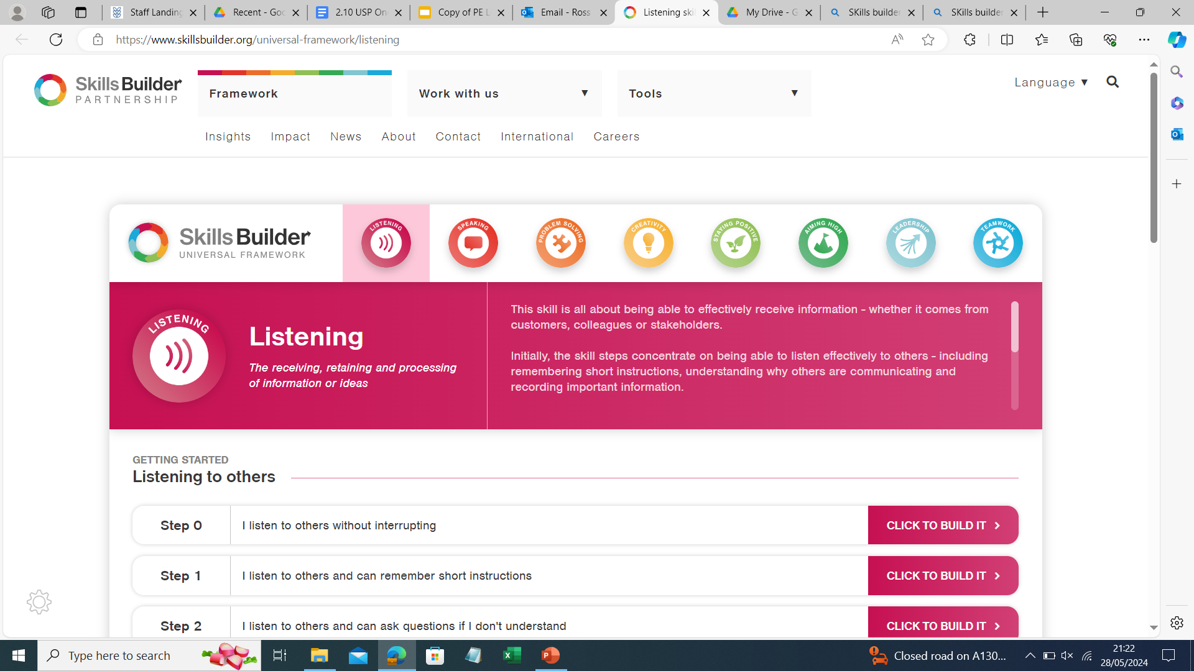
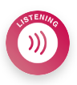
Core Physical Education
Key Stage 4
Key Stage 3 students should:
Be able to apply skills, rules and tactics to a broad range of activities.
Developed their confidence in physical activity.
Understand the importance of a healthy, active lifestyle.
Be able to participate in a activity of choice outside of school with identified pathways available.
Have developed leadership qualities they can apply in a range of contexts.
Consider choosing a qualification in this subject.
Theory underpinning performance
Engage, inspire, lead
Active Healthy balanced lifestyle
Making appropriate decisions to have a healthy lifestyle.
Year
10
Theory underpinning performance
Methods of training
Principles of training
Training zones
Life-long participation
Making appropriate decisions to carry on participating in physical activity or
sport post 16.
Year
11
Stress management techniques
Continue with physical activity or sports Post Key Stage 4.
By the End of Key Stage 4:
Students should:
Be able to enjoy participating in a sport/activity of choice outside of school with identified pathways.
Understand the importance of a healthy, active lifestyle and be able to apply this to their daily routine.

