Slide 1

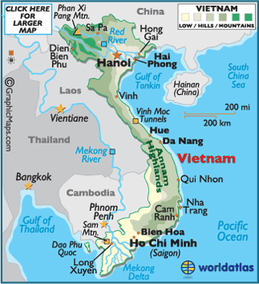
Knowledge Organiser
Paper 3 USA 1954-1975: Vietnam
Key words
Capitalism | A belief in private ownership of the means of creating wealth eg industry and agriculture
Communism | A belief that the means of creating wealth belong to the community. A classless society where there is no private ownership
Cold War | A ‘war’ between the USSR and USA that never turned to actual fighting.
Congress | The US parliament.
Containment | US policy of preventing the expansion of communism into non-communist countries
Defoliants | Chemicals sprayed on plants to remove their leaves
Democratic republic | A country ruled by a popularly elected president
Draft | Compulsory recruitment for service in the military
Gooks | US nickname for the people of Vietnam
Guerrillas | Fighters who avoid big battles and attack through ambushing them and laying traps. Attack and retreat.
Mobile war | A war in which forces are on the move in armoured vehicles, tanks, helicopters etc.
Napalm | Inflammable sticky jelly used in bombs
Silent majority | Moderate people in society who are too passive to make their views known.
Truman Doctrine | The USA’s duty to prevent the spread of communism. President Truman announced he was prepared to engage the USA in military enterprises all over the world to do this.
Vietnamization | President Nixon’s policy of enabling US troops to withdraw from Vietnam by getting the South Vietnamese army to take over.
Strategic Hamlet Program | Diem’s policy of setting up large villages with good facilities in order to keep the villagers loyal to the south Vietnamese government.
Operation Rolling Thunder | American bombing campaign of North Vietnam
Search and destroy | American military tactic used to search out VC and destroy their hideouts/villages
Tet | Vietnamese new year
Key Events
1954 | Viet Minh defeat the French at Dien Bien Phu. End of French colonial rule. Vietnam divided in to two states – north and south.
1955 | Diem cancels elections
1960 | Formation of the Viet Cong
1961 | JFK sends more advisers
1962 | Strategic hamlet program
1953 | Buddhists protests, Diem overthrown and killed
1964 | Gulf of Tonkin Incident
1965 | First US soldiers land in South Vietnam. Op Rolling Thunder.
1968 | Tet Offensive Mai Lai Massacre Johnson resigns
1969 | Vietnamization. Death of Ho Chi Minh. My Lai massacre revealed.
1970 | Invasion of Cambodia Kent State shootings
1972 | NVA invade South Vietnam. Operation Linebacker. Formal peace talks begin.
1973 | Paris Peace Accords
1975 | Fall of Saigon, collapse of South Vietnam.
Key organisations
Viet Minh | The League for the Independence of Vietnam
Viet Cong (NLF) | National Liberation Front (nickname VC)
ARVN | South Vietnamese Army
NVA | North Vietnamese Army

