Slide 1

Year 12
Revision and note taking

Slide 2
Subject 1 | Subject 2 | Subject 3 | Subject 4 | Subject 5 | Subject 6 | Subject 7 | Subject 8 | Subject 9 | Subject 10 | Subject 11
Subject 1 | Subject 2 | Subject 3

Slide 3

Note taking how do you take yours?

Slide 4
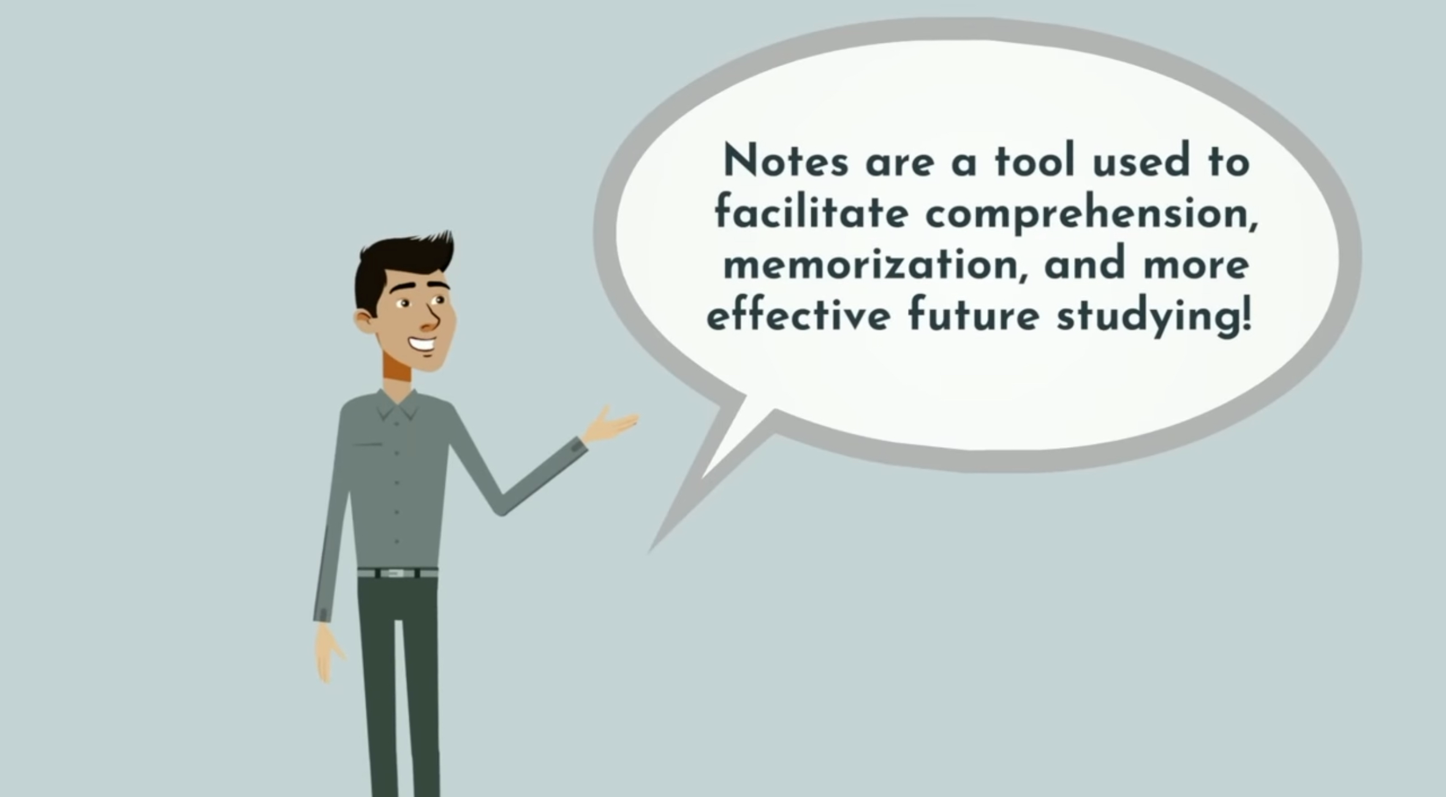
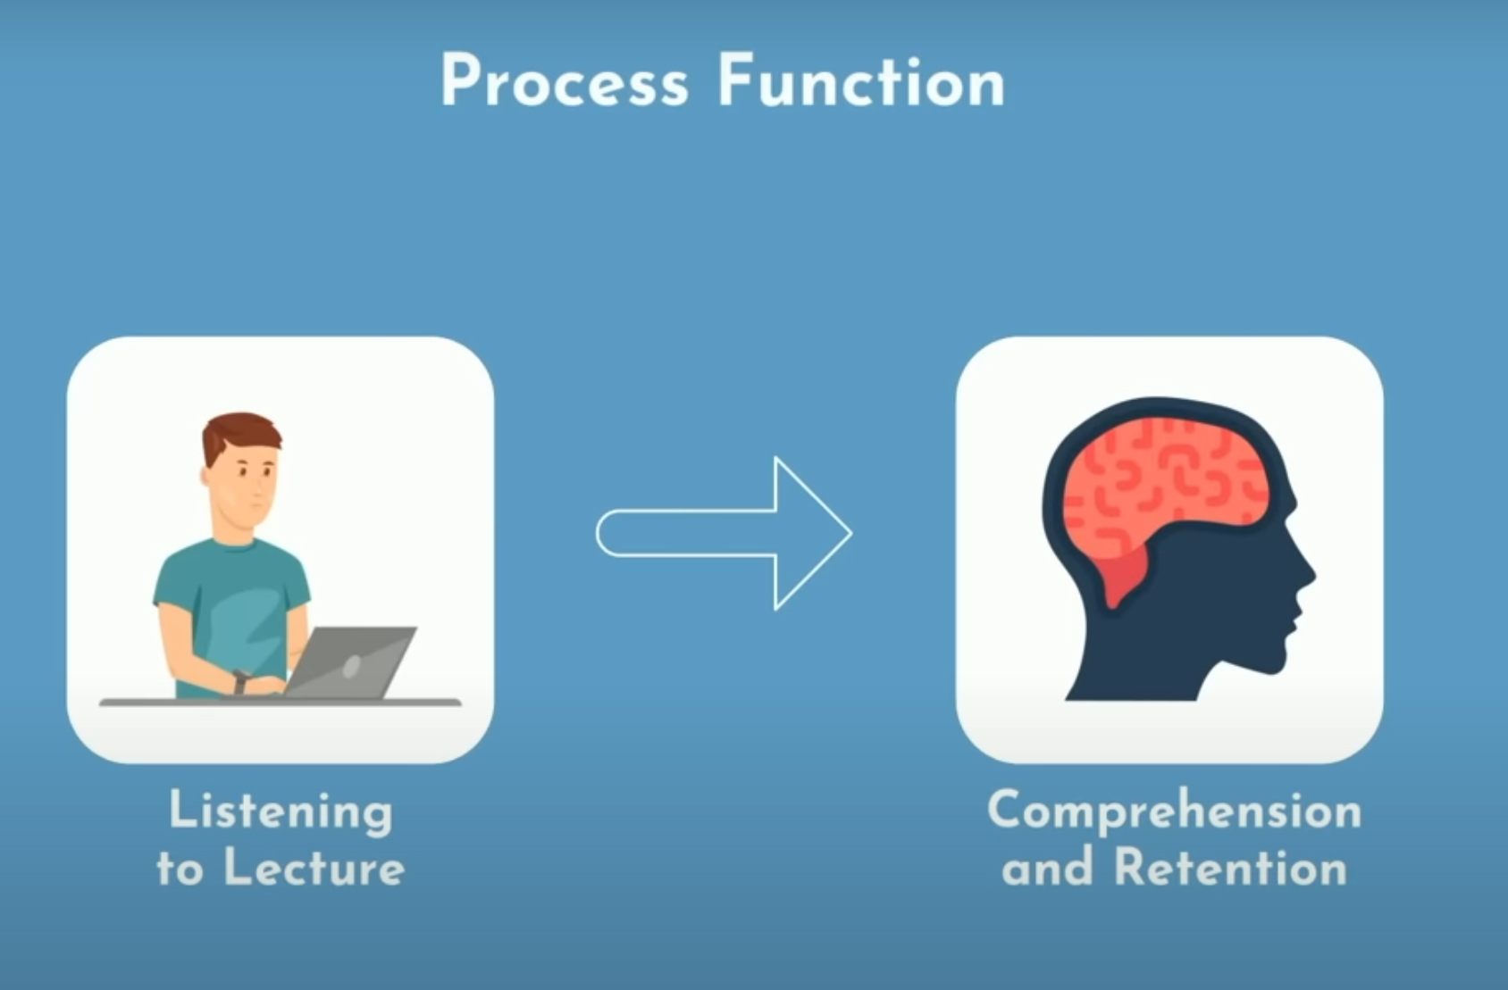
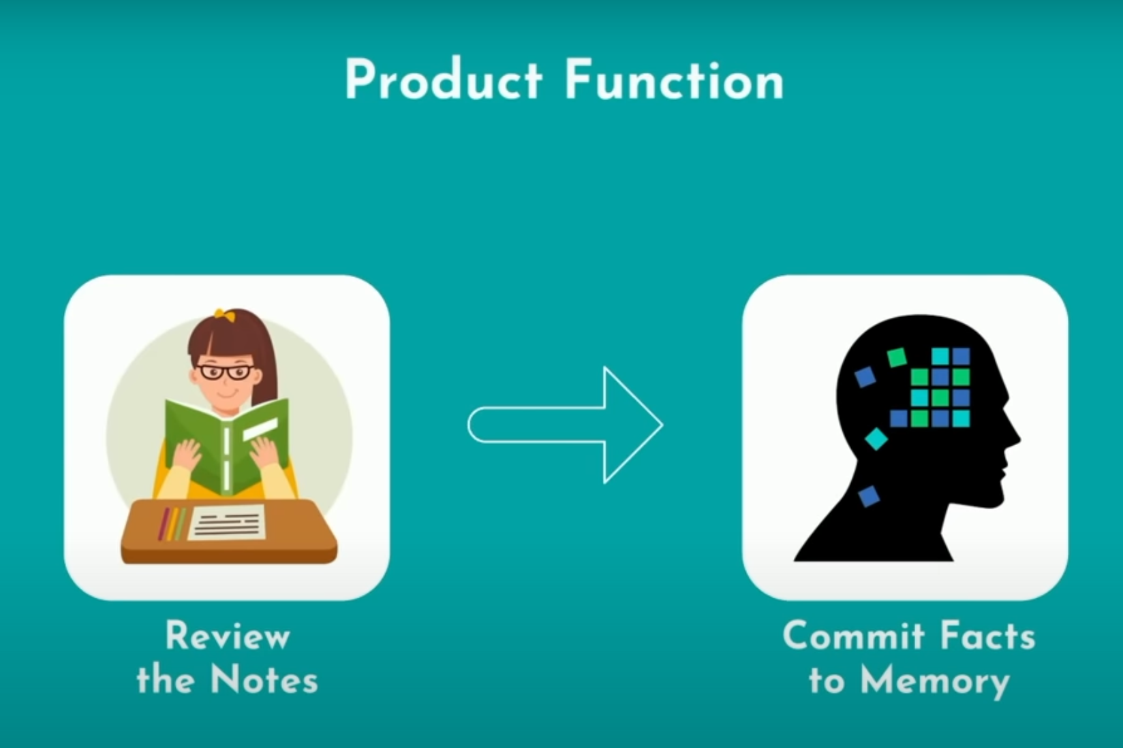






Writing everything that’s on the board or that’s in the textbook.
Writing every word your teacher is saying.

Slide 5
https://www.youtube.com/watch?v=uy6Eu5l0yOk

Slide 6
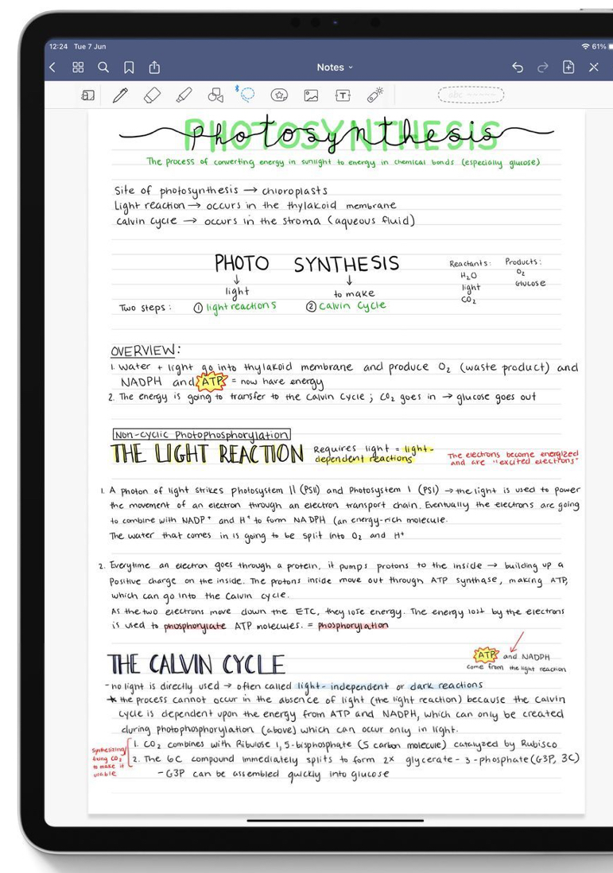
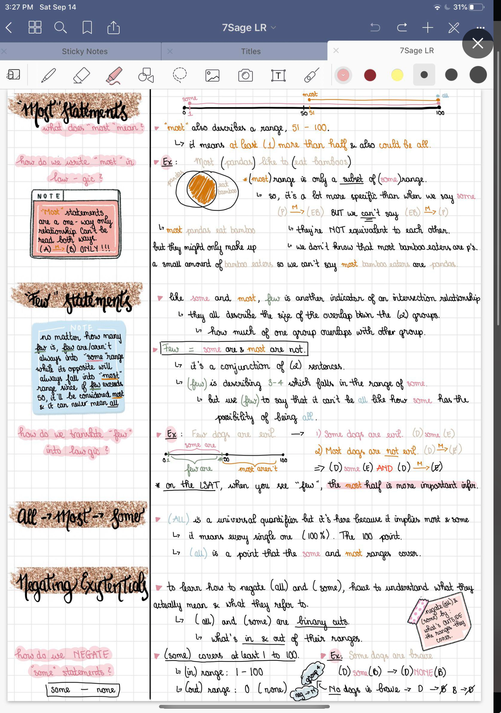
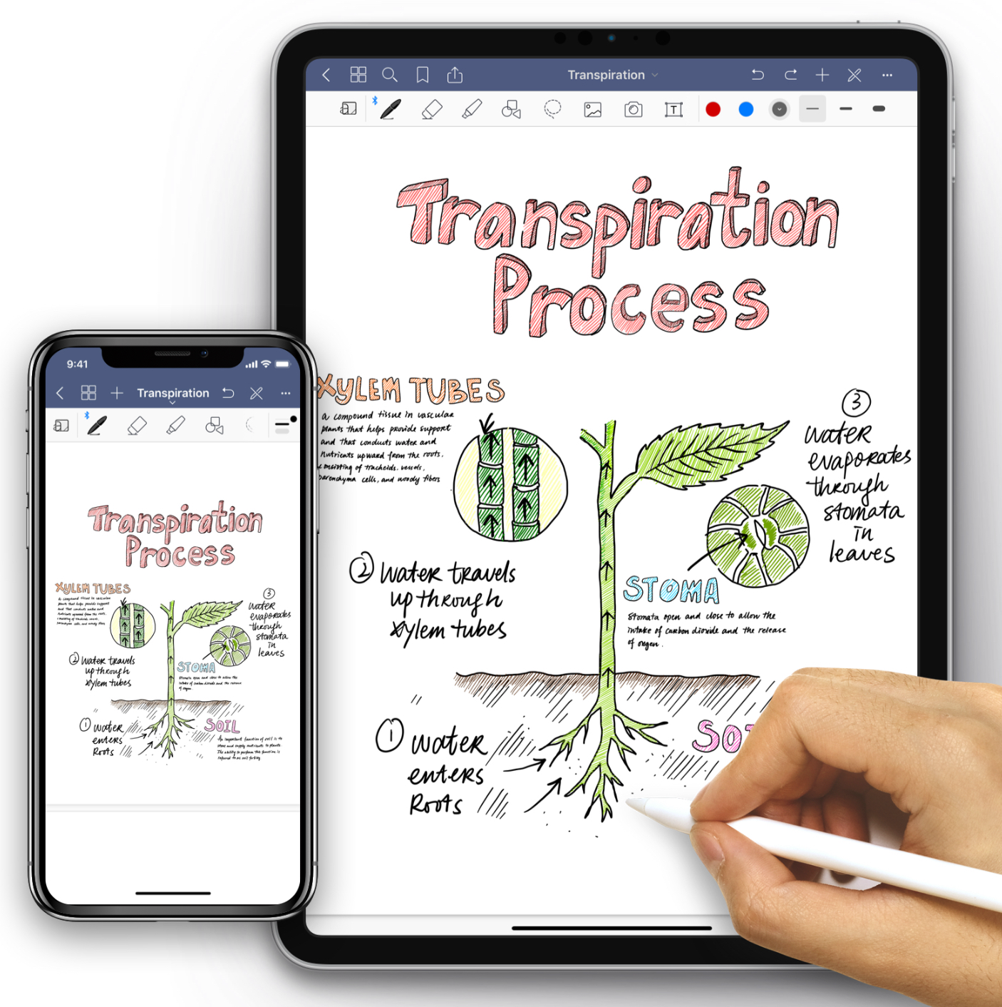




Slide 7
Note taking
Read through everything first – if you make notes on the first time of reading, everything will feel important.
Close or cover what you’ve read – what were the key ideas?
Leave lines between your notes – this means that if you have missed something there is space to go back and add more in.

Slide 8


Revision…

Slide 9
But it’s only October and we’re still in Year12…!

Slide 10

Challenge the misconception…
Notes:
Asked to talk about revision
most of us have a misconception about revision, I’m going to try and change that.
At the moment – revision maybe fills us with dread

Slide 11



Notes:
Because these are the connotations we’ve attributed to it.
We sit down, open our notes…
Start to feel like we don’t really know where to start because there’s so much to do…
Then we feel completely overwhelmed and either walk away, sit there and cry, or make limited progress and feel emotionally exhausted after 20 mins

Slide 12
Revision is a big, stressful scary thing that happens at the end of content before an assessment and no one enjoys doing it!
Notes:
This is what we end up seeing revision as

Slide 13

Stress is how we react when we feel under pressure or threatened. It usually happens when we are in a situation that we don't feel we can manage or control.
Notes:
And this is how we feel.
Like there’s so much pressure, because there’s so much to learn. And we have little or no control and we don’t feel like we can manage to deal with it all or know how to navigate our way through it successfully

Slide 14
So we avoid the thing that a) we don’t enjoy and b) makes us feel stressed. and we avoid revising.
Notes:
And this is how we feel.
Like there’s so much pressure, because there’s so much to learn. And we have little or no control and we don’t feel like we can manage to deal with it all or know how to navigate our way through it successfully

Slide 15
CRAMMING WORKS!
BUT ONLY SHORT TERM
Notes:
So we end up cramming.
The problem is… cramming works! No one would do it if it didn’t.
But it only works short term.
Use paper to demonstrate topic.
We get to the night before or the morning of an EOU and we cram. We read though x5 feel like it’s familiar, sit the test and pass (maybe only just). But because that information is only in our STM, by the time we have to remember it again – it’s gone.
But this time, we have to remember that topic and 3 others that we crammed the EOU for too. (add more paper!!)
Now cramming isn’t really an option – because there’s just too much

Slide 16
Re
vision
See Again
We’re just looking at it again – to help it move from your STM to your LTM
Notes:
And so we need to stop seeing revision as something that happens at the end
Revision happens ALL THE TIME, but it’s not scary. It happens every time you look again at content. Every time you make a link. Every time you answer an exam question.
The aim of revision is simply to ‘look again’ but in an education context, the secondary aim is that that information then moves from our STM to LTM so that we remember it over a long period of time

Slide 17
Learning is
‘a change to long term memory’
(Kirschner, Sweller and Clark, 2006)
Notes:
Because that’s what learning is… a change in our LTM. So we need to find a way to get this information into our LTM and not just cram it into our STM were we’re just going to forget it again.
How do we do that? How do we make it effective, and so it doesn’t feel so completely overwhelming.
Because often times, we feel like we’ve tried and it’s not always worked out for us…. We feel like our methods don’t work, we don’t LEARN and so we give up.
So I first of all want to challenge something that you’ve probably been told many times….

Slide 18
(sorry!!)
MOTIVATION
maintains
Stops if we don’t see
SUCCESS
Notes:
In the first instance… motivation does not always lead to success.
Keepy uppy story. I wasn’t successful – so I gave up.
We need to find ways of feeling successful. Because our success is going to motivate us to continue.

Slide 19
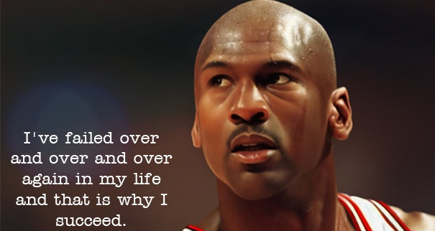

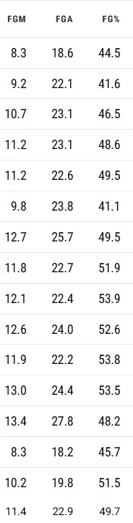
Notes:
Had Michael failed EVERY SINGLE TIME – he might have given up.
He continues because sometimes he gets it right!
Yes, he learns from his mistakes – they make him BETTER, but the success he achieves is really what keeps him going.

Slide 20
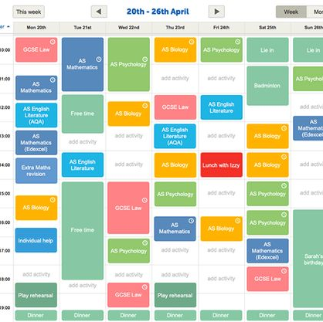

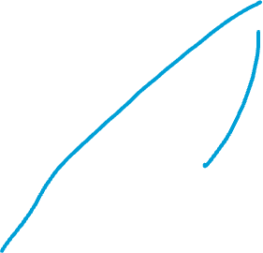



Make a plan and make it effective
How are you using your study time?
Getrevising.com
Monday | Tuesday | Wednesday | Thursday | Friday
Biology | Art | History | History
Art |  | Biology | Biology | History
Biology | History |  | Art | Art
Notes:
You should NEVER! Alberta able to say – I’ve done all my work!

Slide 21
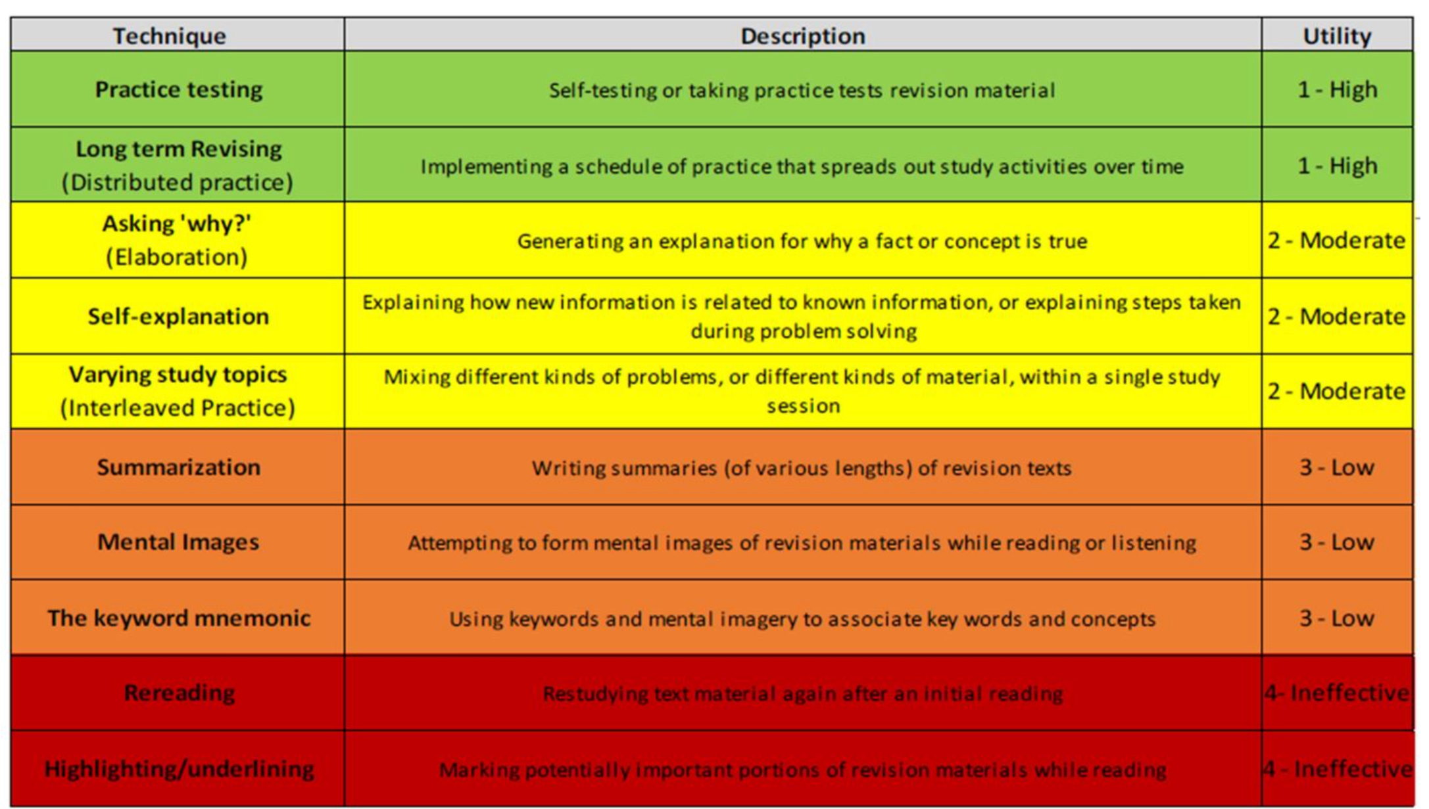

Slide 22
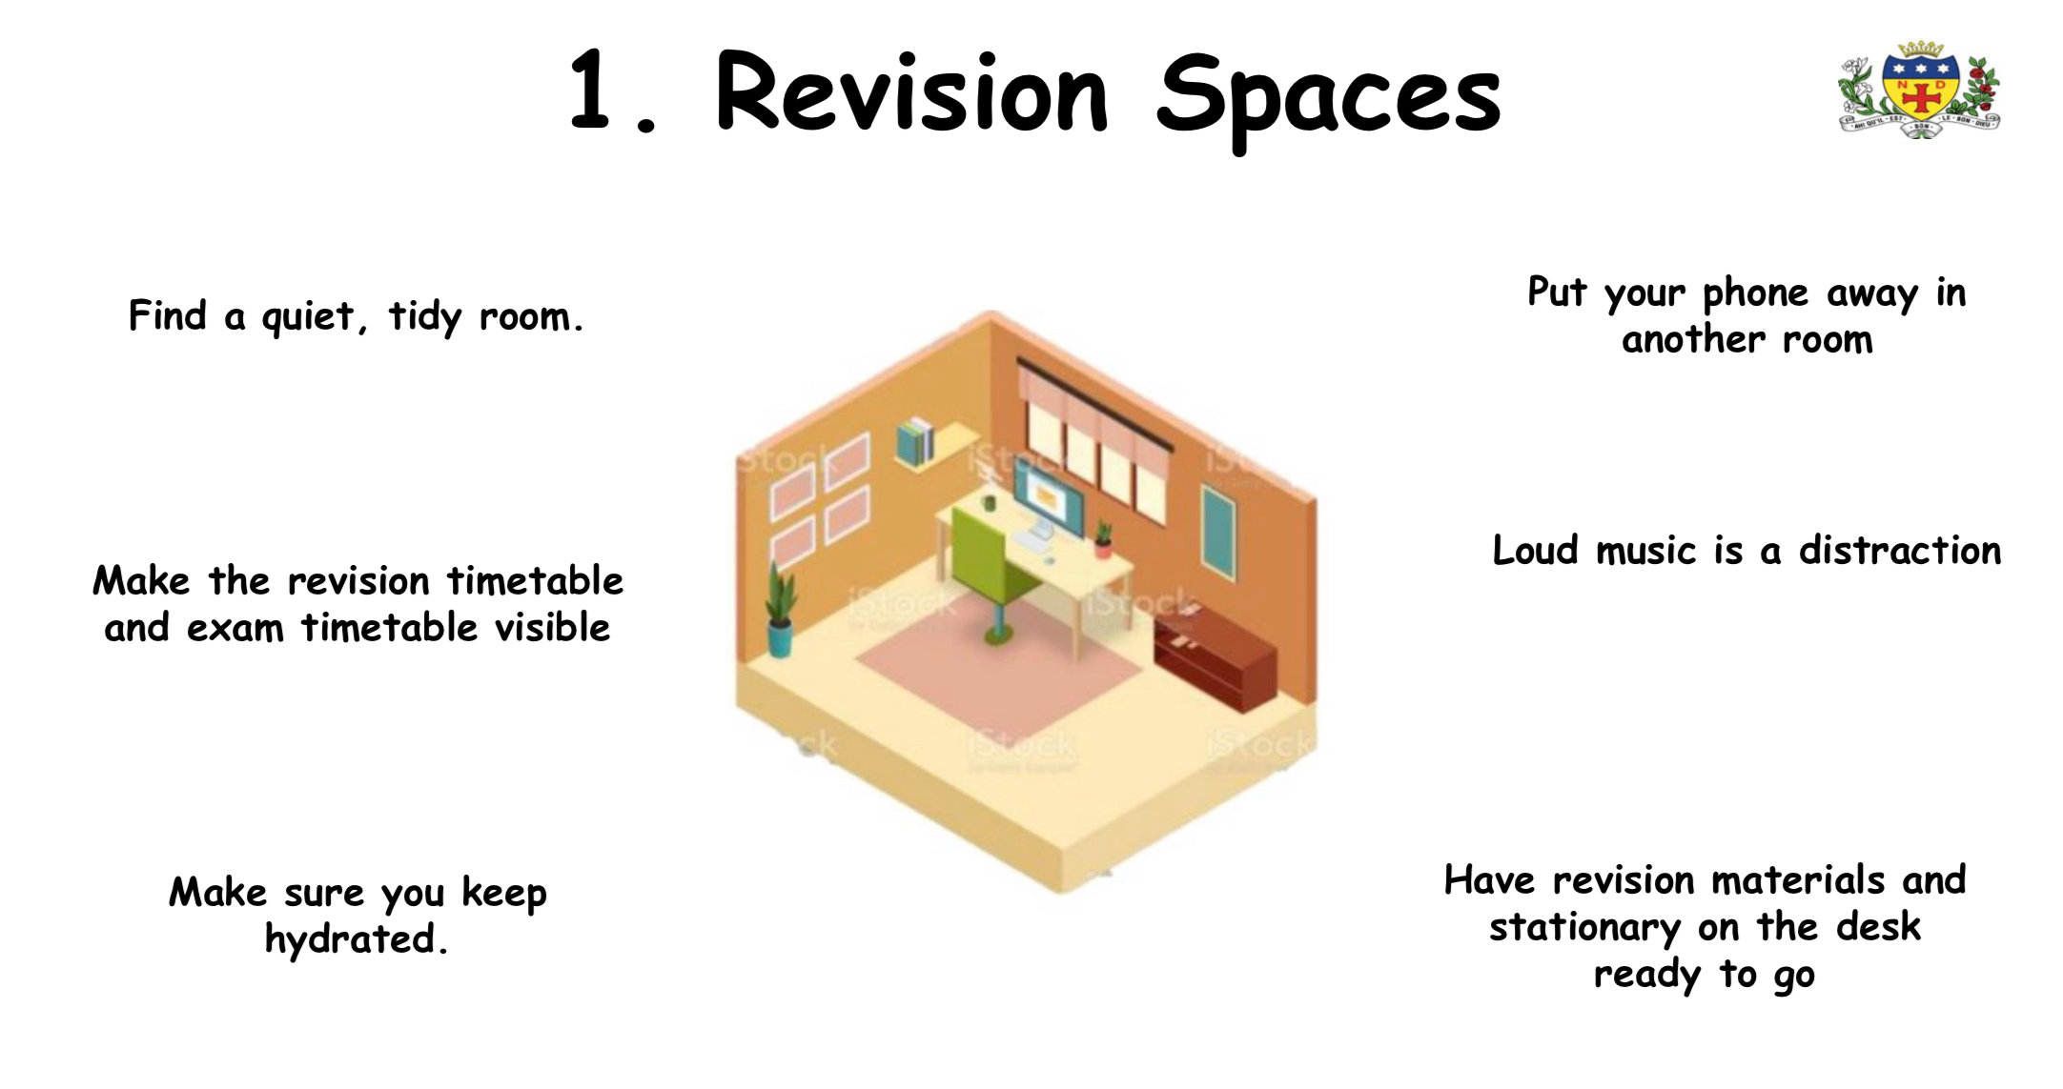



















Slide 23
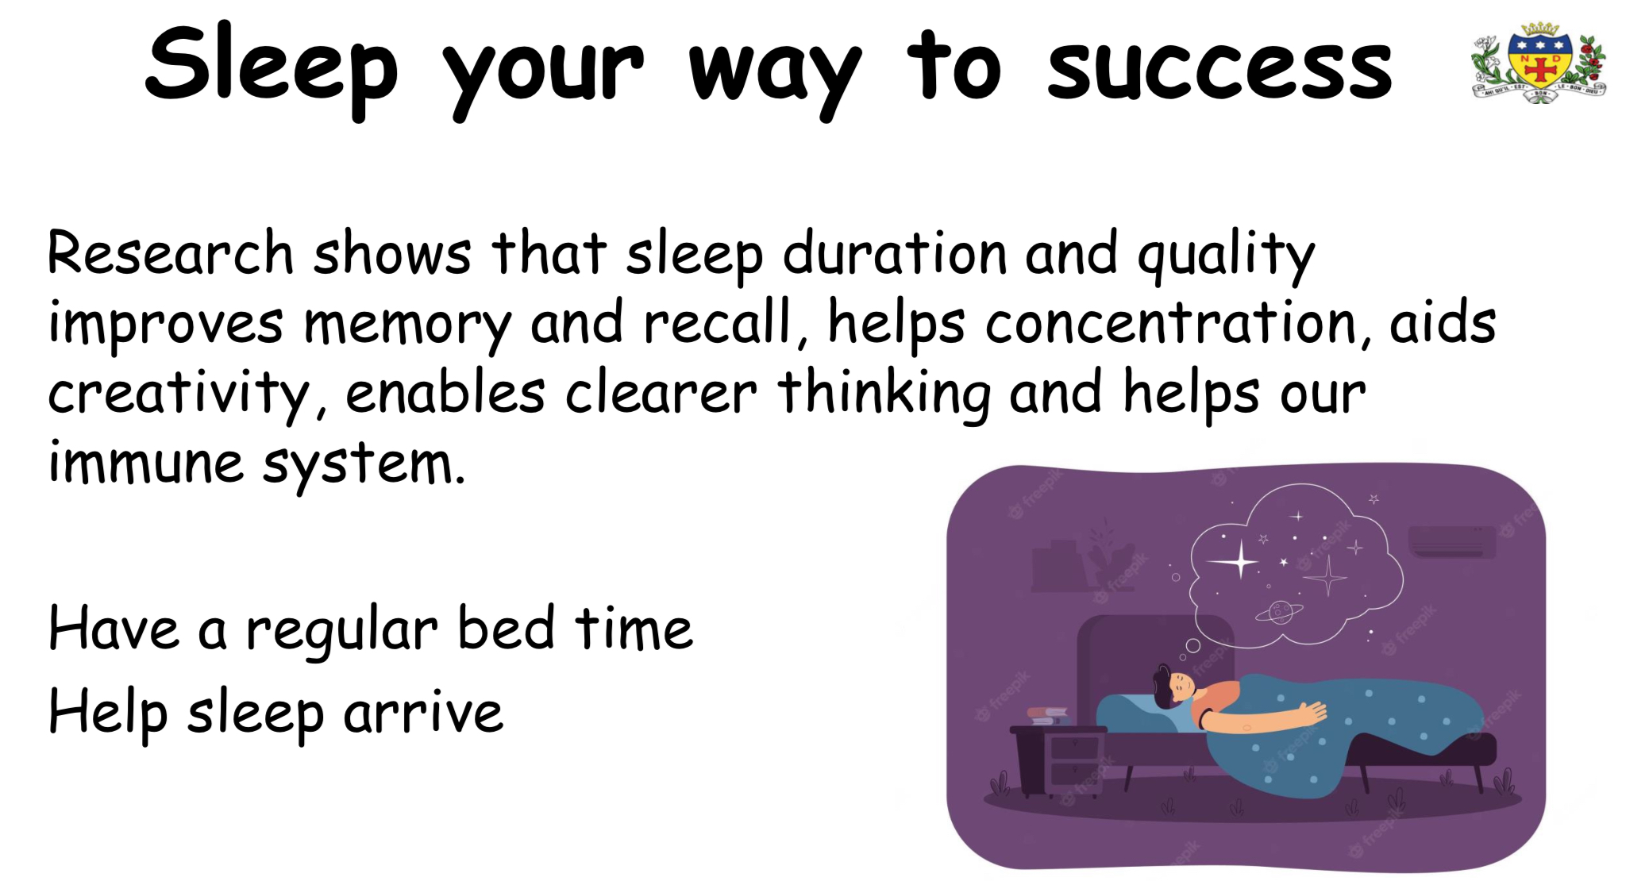


Slide 24
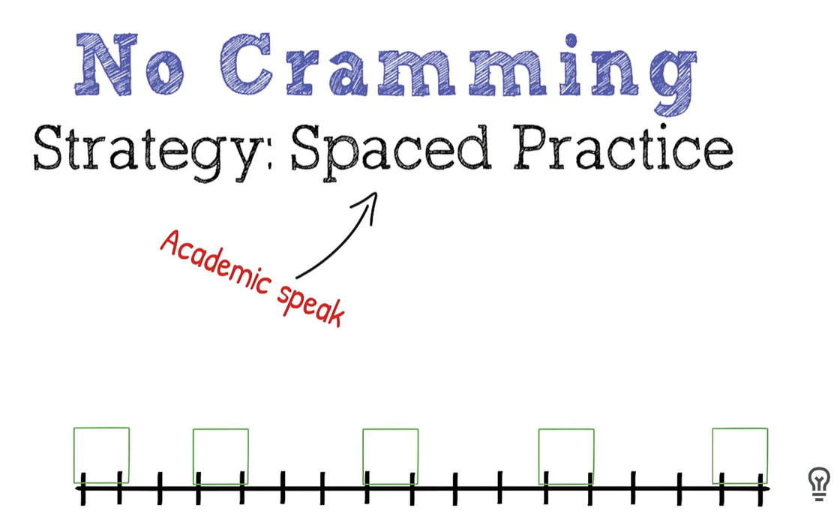
Little and often

Slide 25
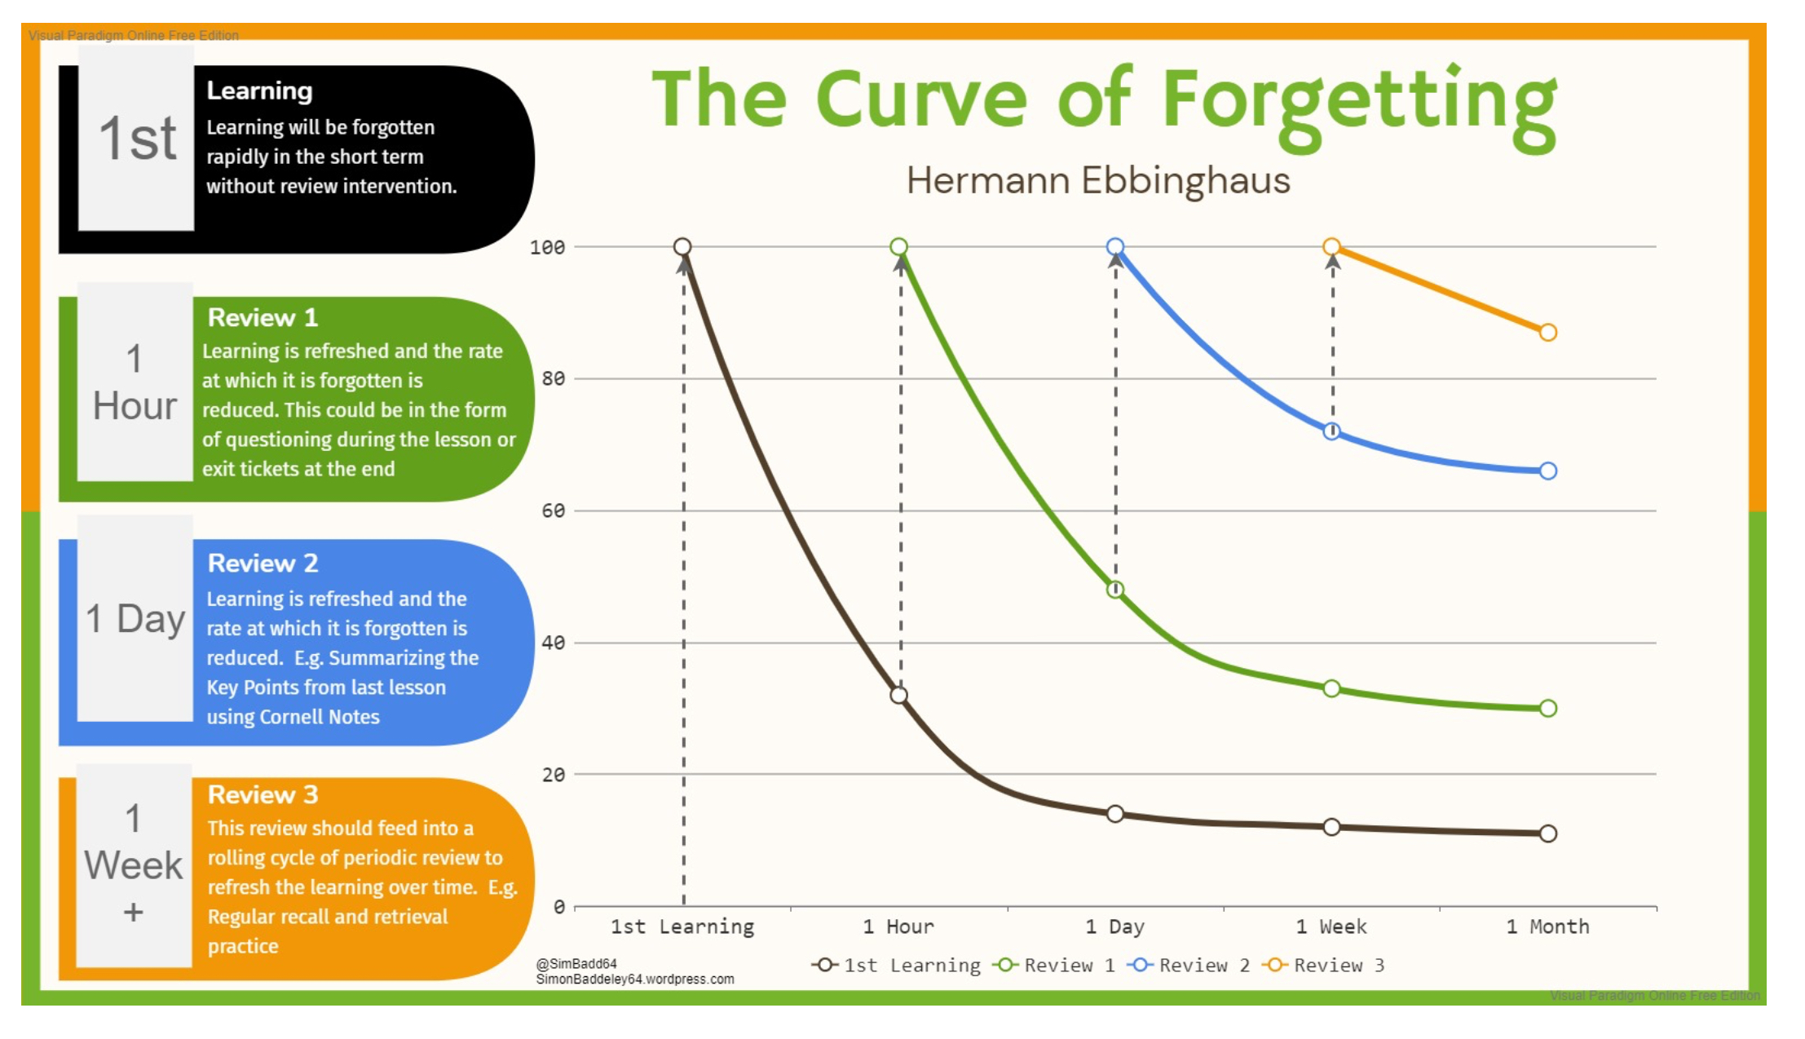

Slide 26

Test yourself first!
Work out what you know!
But it HAS to be low stakes!

Slide 27
FIND SOME SUCCESS
- You don’t need to keep revising what you already know!
AND YOU WILL KNOW STUFF!

Slide 28
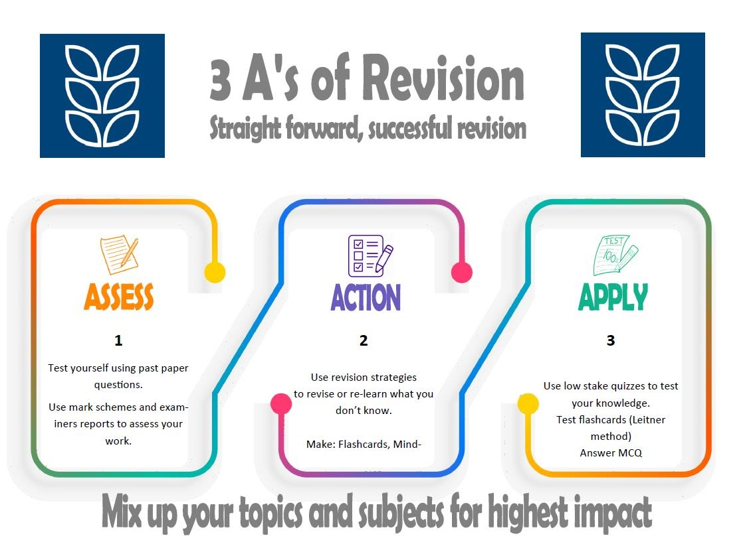
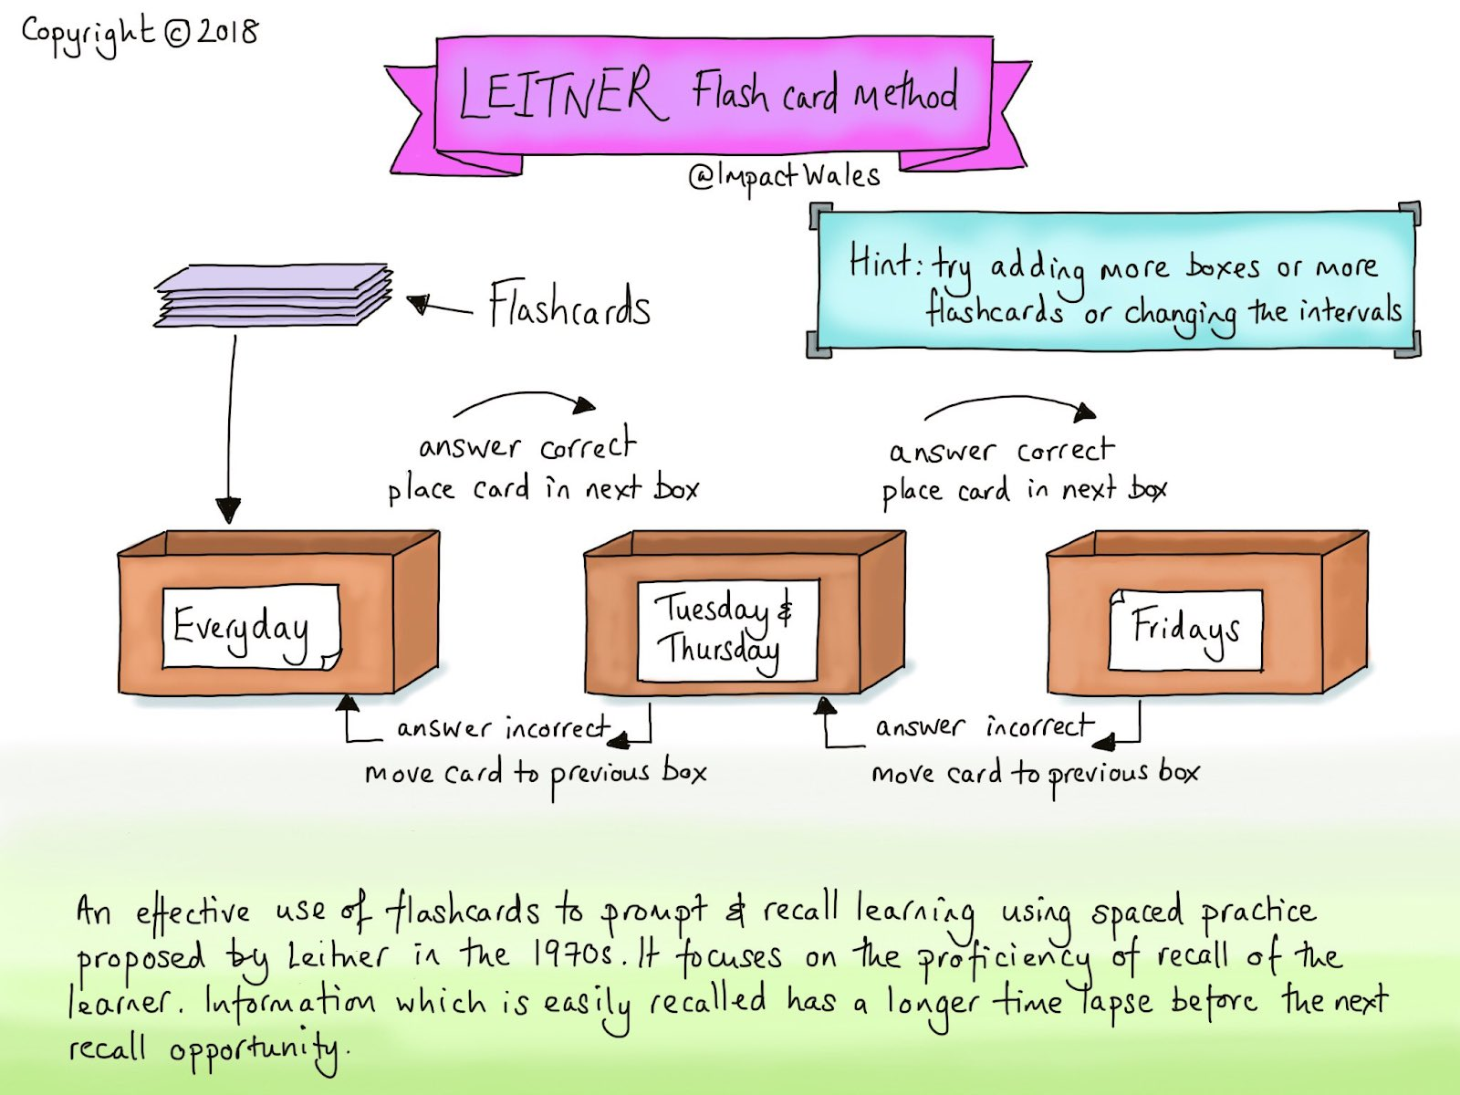


Making it effective!

Slide 29
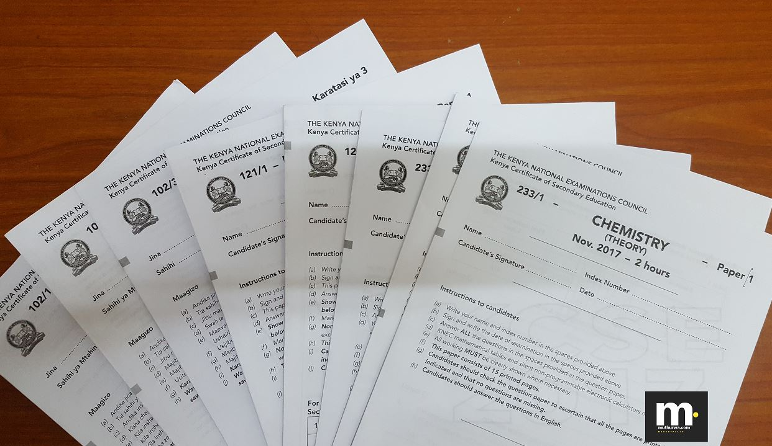
Making it effective!

Slide 30
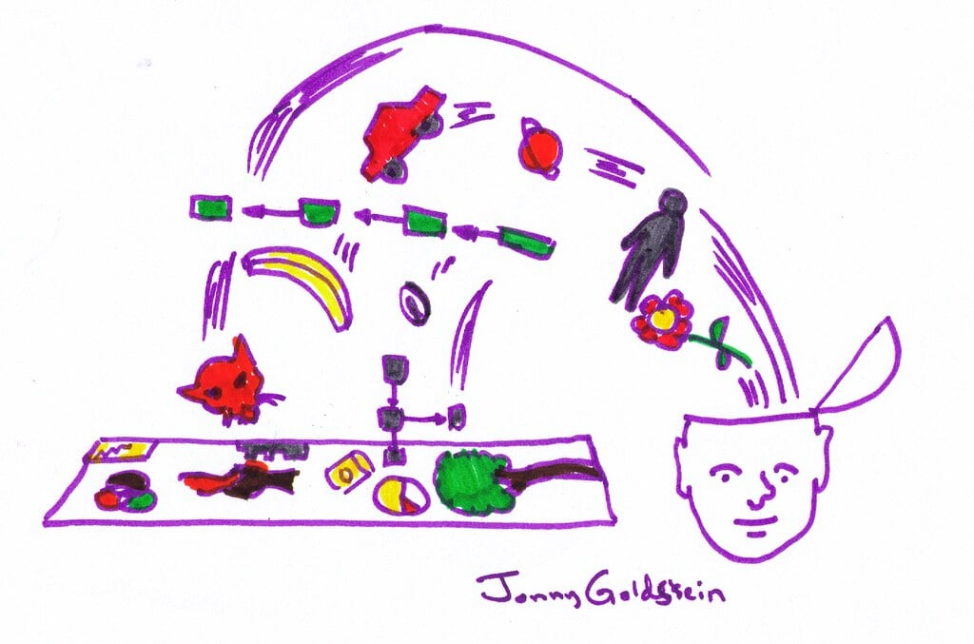
Making it effective!

Slide 31

You don’t need to keep revising what you already know – so take it out of the box
Notes:
Psychology students don’t revise mean median and mode as part of their revision for the mathematical elements – they know it already.

Slide 32


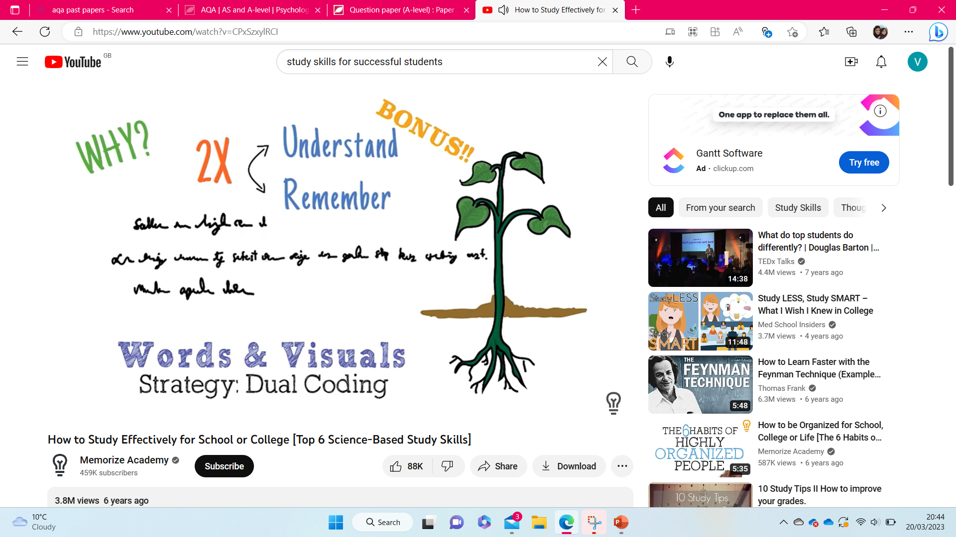
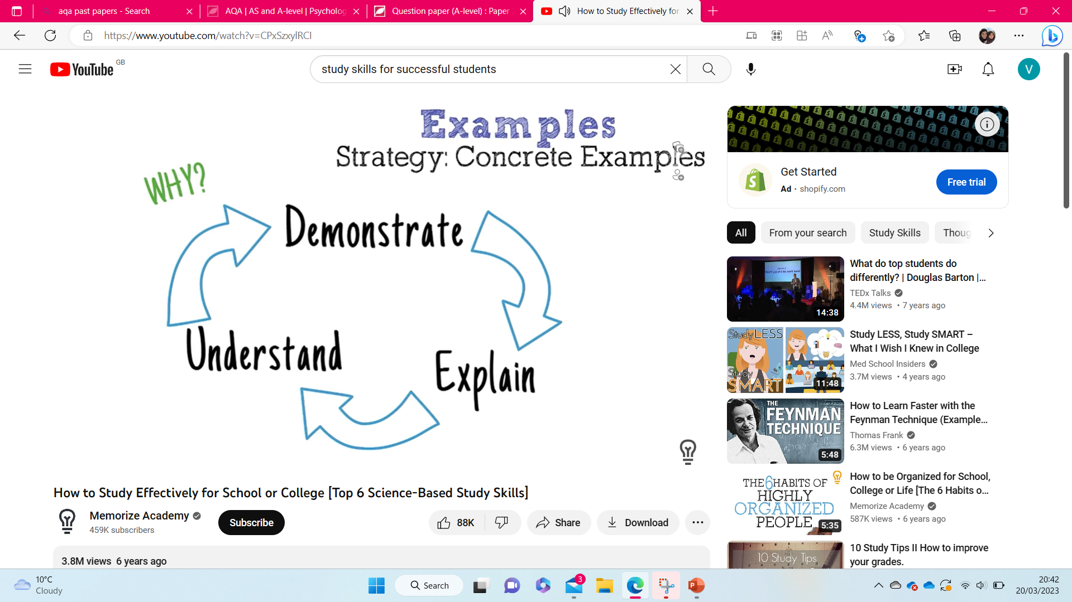
Sort out what’s left!

Slide 33
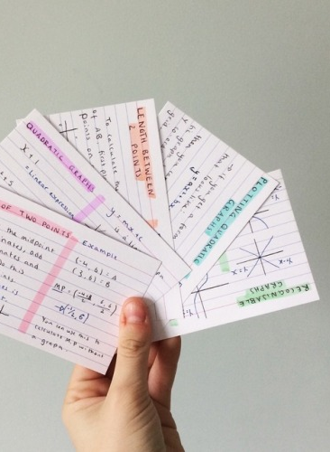


Check what you know now…

Slide 34
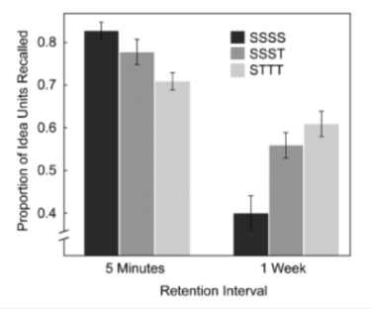
Notes:
Rationale behind testing!

Slide 35
Then see what’s left in the box, what do you need to check again. Once you know it – take it out!

Slide 36
And repeat!

Slide 37
Just check the stuff you know now and again
Notes:
And if you’re completing past papers or quizzes regularly, you’ll bump into this content anyway!

Slide 38
