Slide 1


Year 13
Revision and note taking

Slide 2

Note taking how do you take yours?

Slide 3
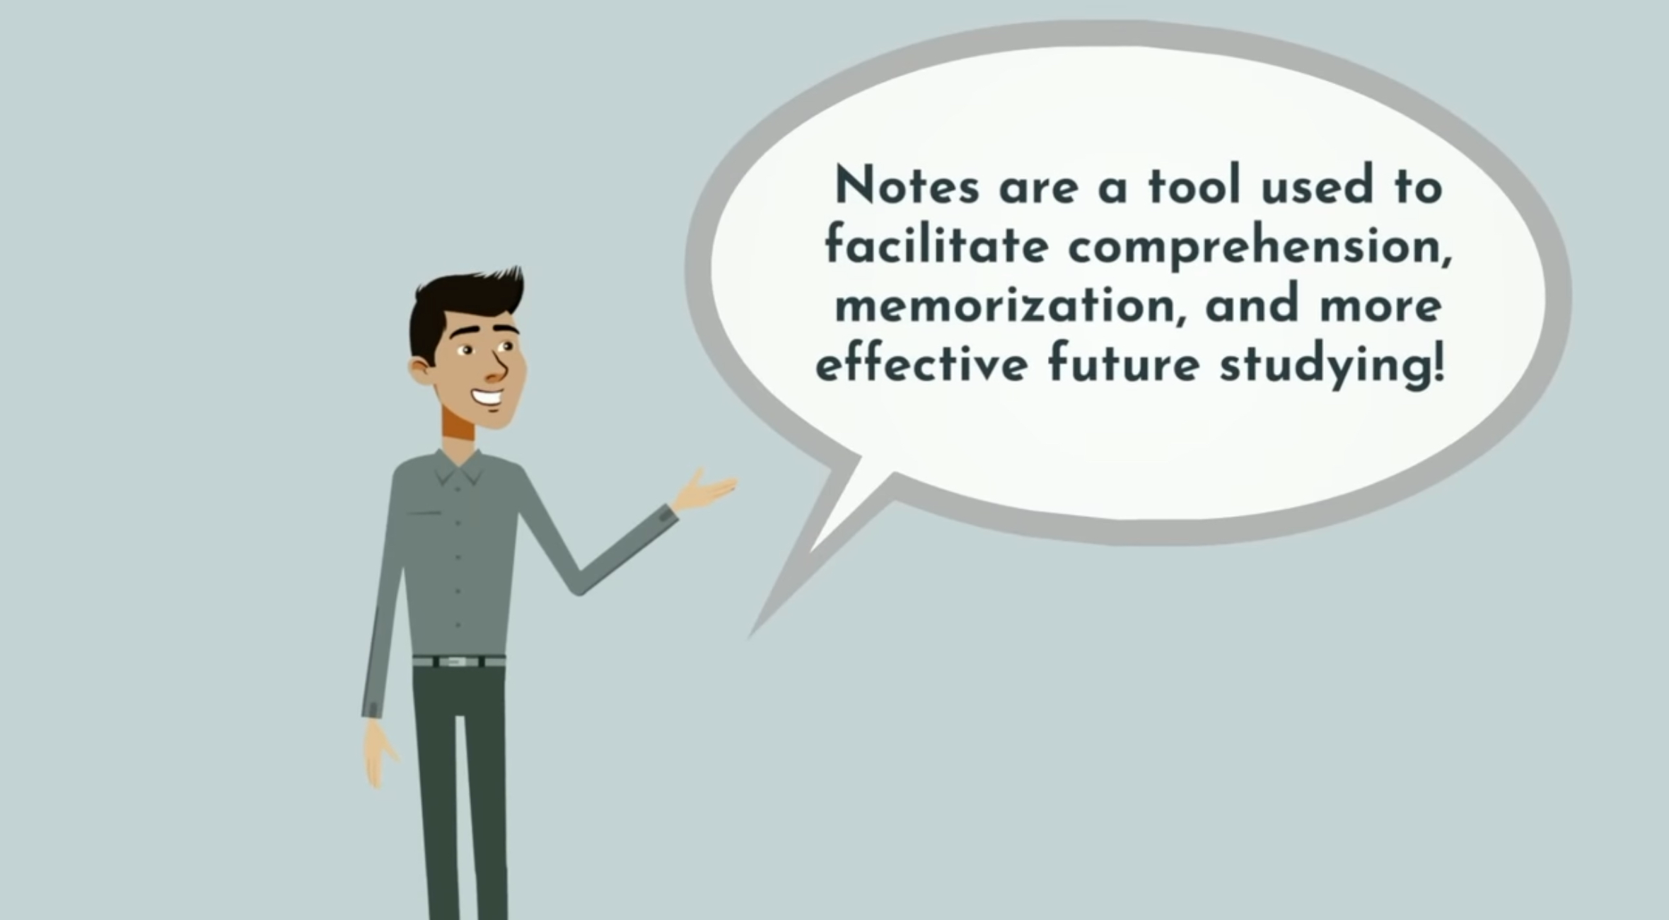
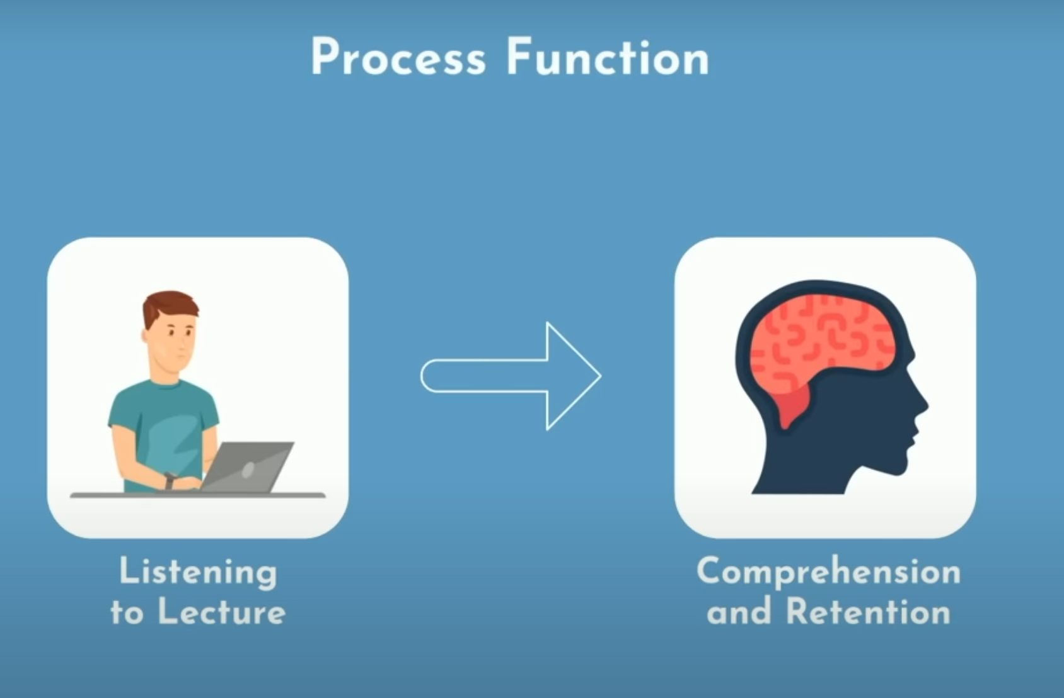
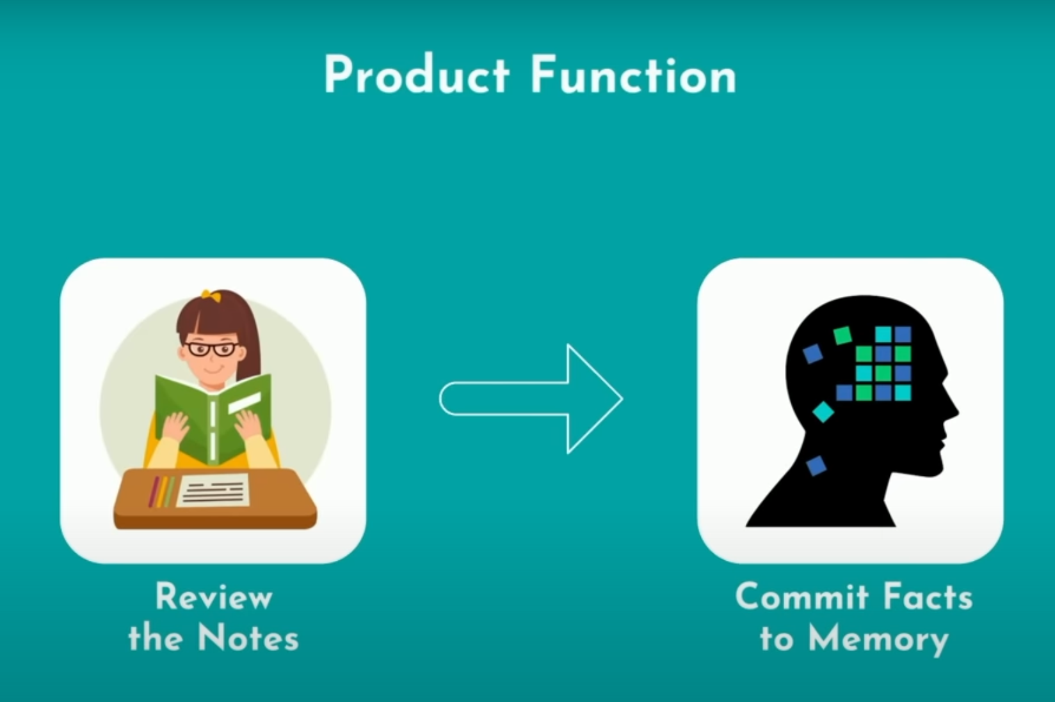






Writing everything that’s on the board or that’s in the textbook.
Writing every word your teacher is saying.

Slide 4
https://www.youtube.com/watch?v=uy6Eu5l0yOk

Slide 5
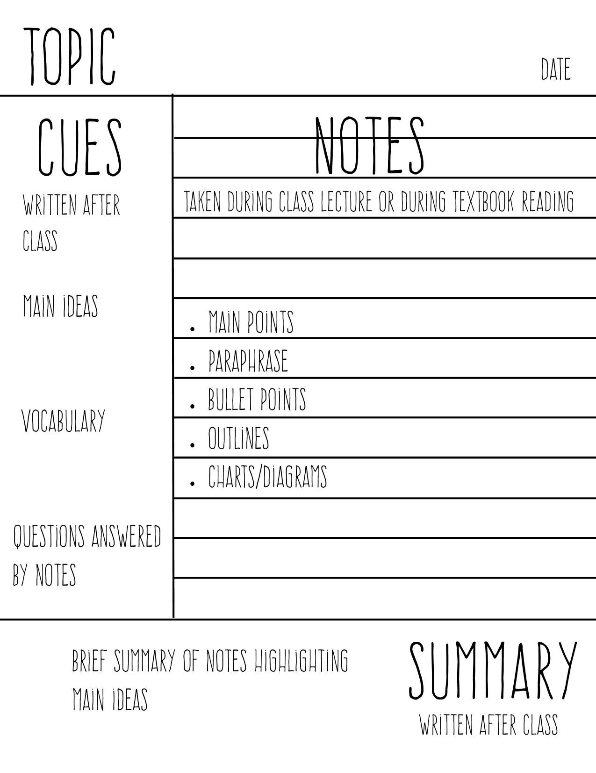
Cornell notes
Helps to consolidate and work out if you’ve understood your class notes
Helps to process the notes that you’ve made and organise them effectively
Becomes a ready-made revision aid

Slide 6

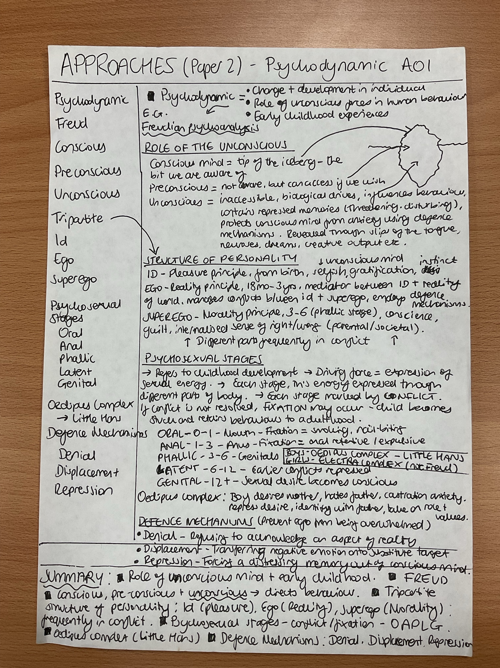
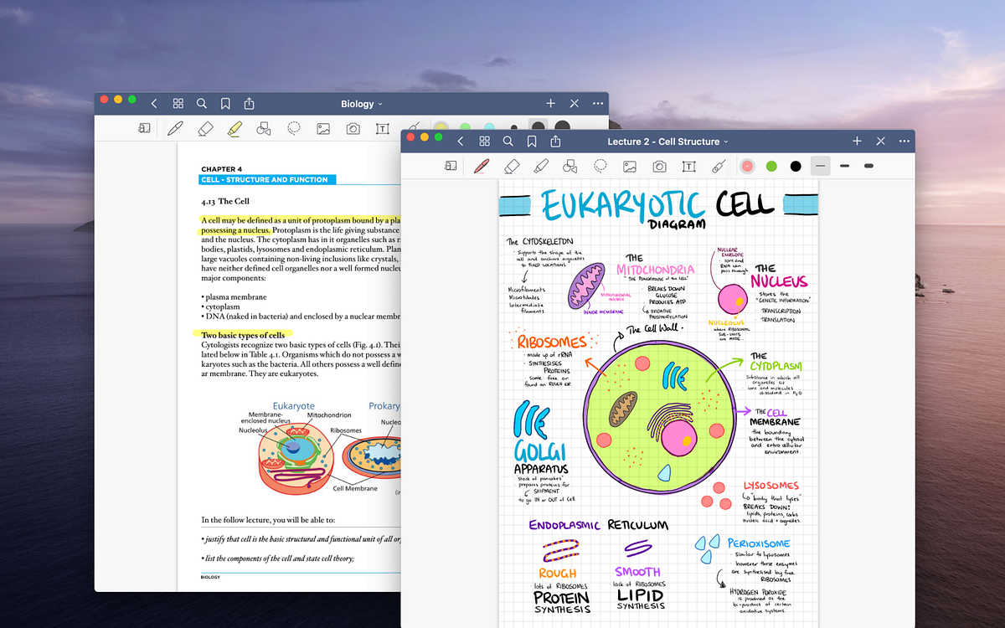
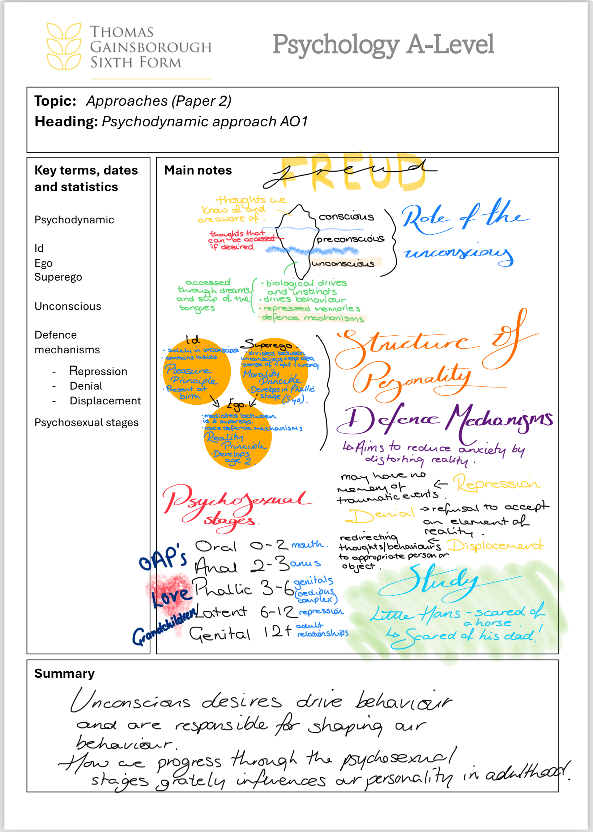
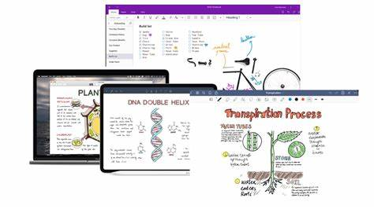

Slide 7


Revision…

Slide 8

Cheap time vs
Expensive time

Slide 9
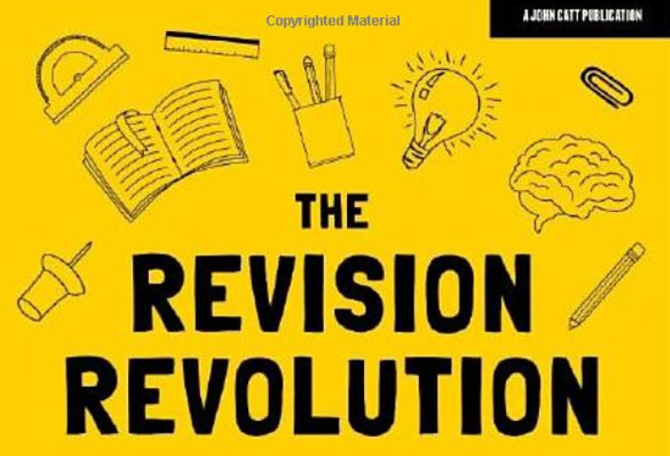
Challenge the misconception…
Notes:
Asked to talk about revision
most of us have a misconception about revision, I’m going to try and change that.
At the moment – revision maybe fills us with dread

Slide 10
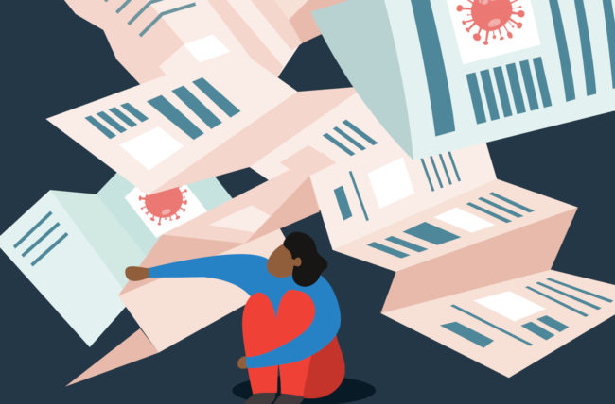


Notes:
Because these are the connotations we’ve attributed to it.
We sit down, open our notes…
Start to feel like we don’t really know where to start because there’s so much to do…
Then we feel completely overwhelmed and either walk away, sit there and cry, or make limited progress and feel emotionally exhausted after 20 mins

Slide 11
Revision is a big, stressful scary thing that happens at the end of content before an assessment and no one enjoys doing it!
Notes:
This is what we end up seeing revision as

Slide 12

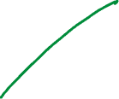





Cheap time is here, and now!

Slide 13





Little and often
Notes:
Go back to pile
Demonstrate that if we LEARN a little (and get it into our LTM) then we have less to ‘revise’ at the end.
We’ve spread out this CLOUD

Slide 14







Expensive time is later

Slide 15
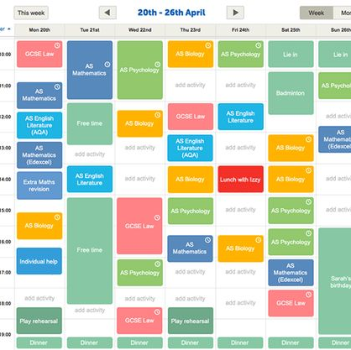




Make a plan and make it effective
How are you using your study time?
Getrevising.com
Monday | Tuesday | Wednesday | Thursday | Friday
Biology | Art | History | History
Art |  | Biology | Biology | History
Biology | History |  | Art | Art
Notes:
You should NEVER! Alberta able to say – I’ve done all my work!

Slide 16
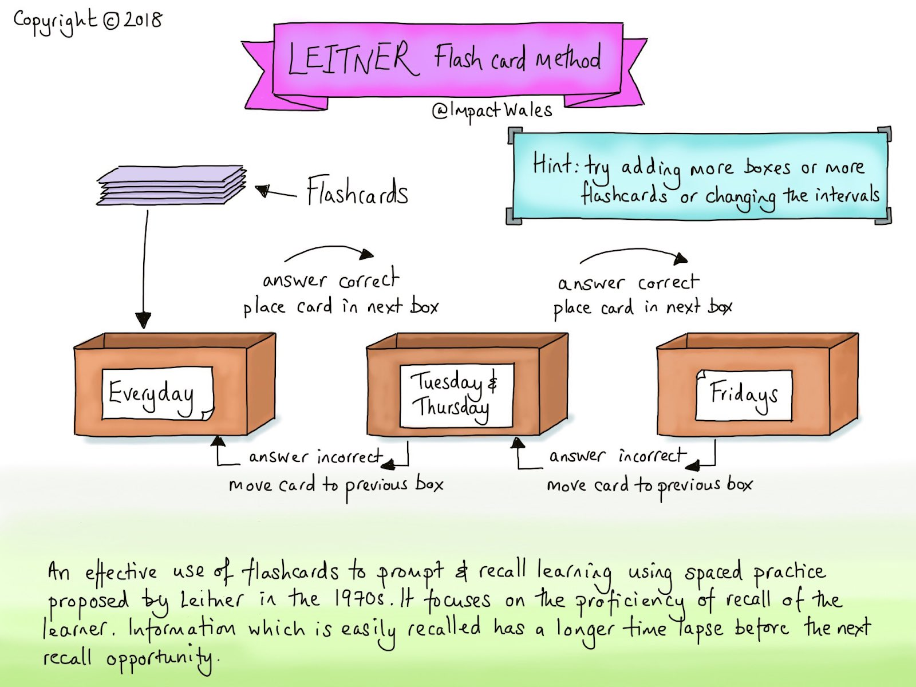


Making it effective!

Slide 17
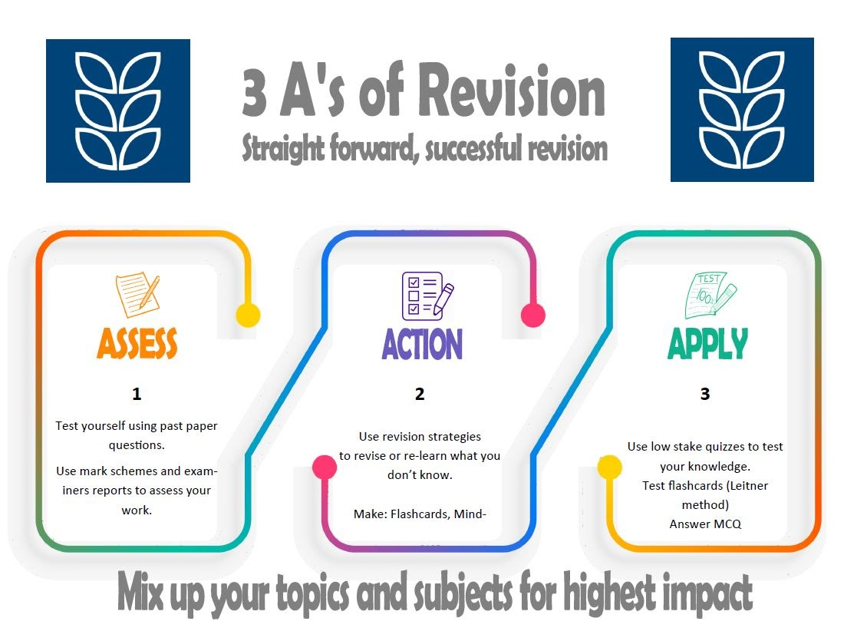

Slide 18
Mix it up
Cornell notes
Flash cards
Knowledge books
Kahoots
Past papers
Key terms definitions
Seneca
Uplearn

Slide 19
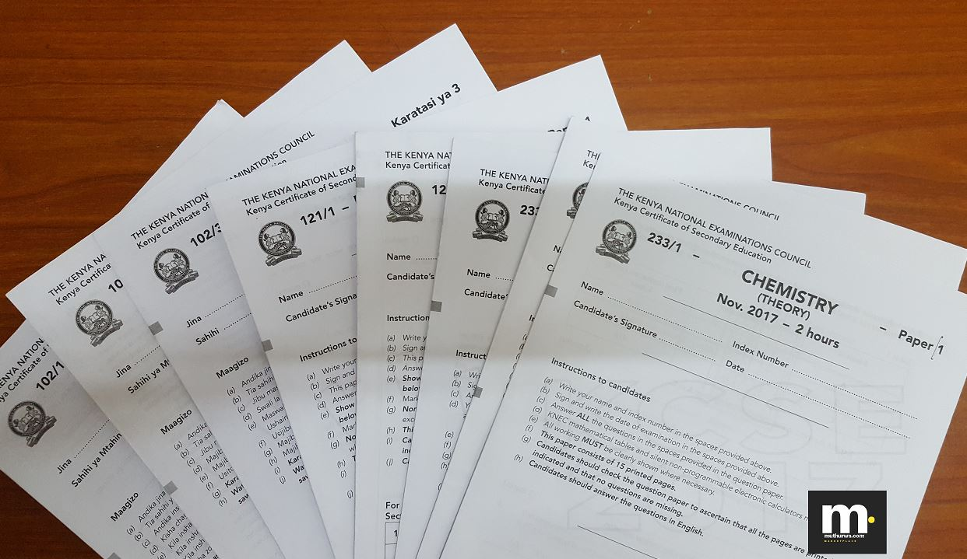






Past papers do’s and don't
Do use them as a revision tool
  Don’t treat them like an assessment!
Do use the mark schemes
  Don’t assume because you’ve asked the question that you’ve got it all right!
Do time yourself
  Don’t feel you have to do it all at once!

Slide 20
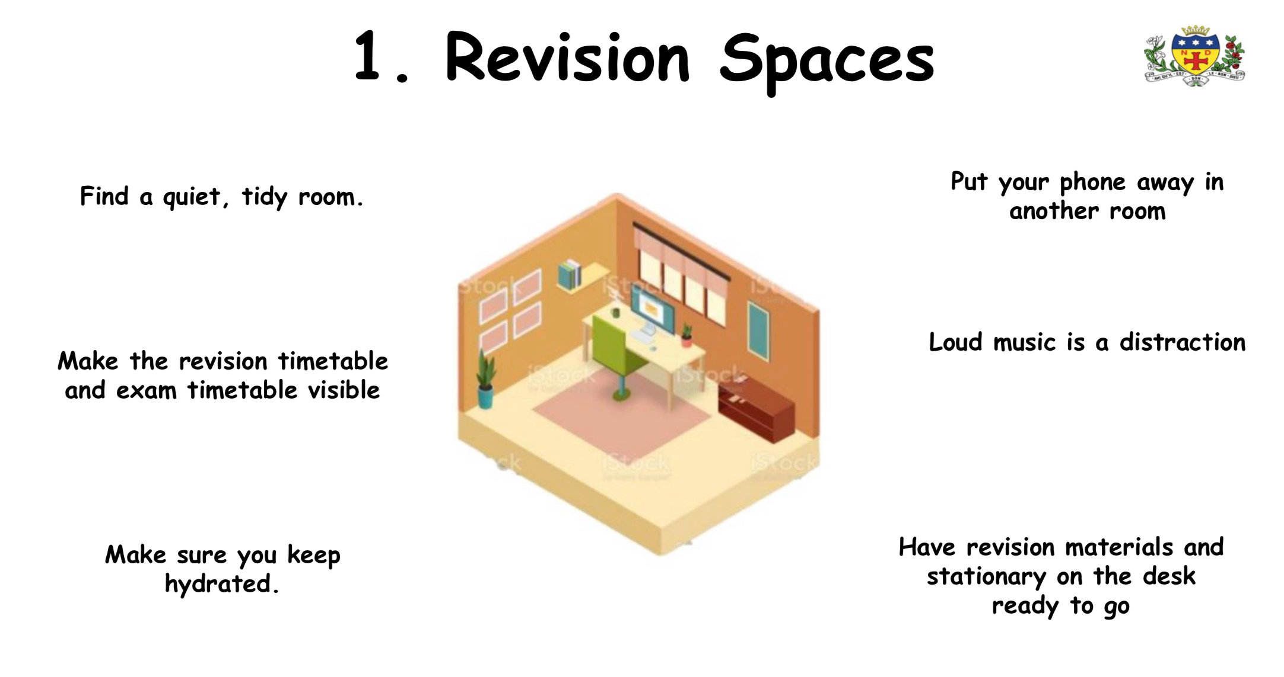



















Slide 21
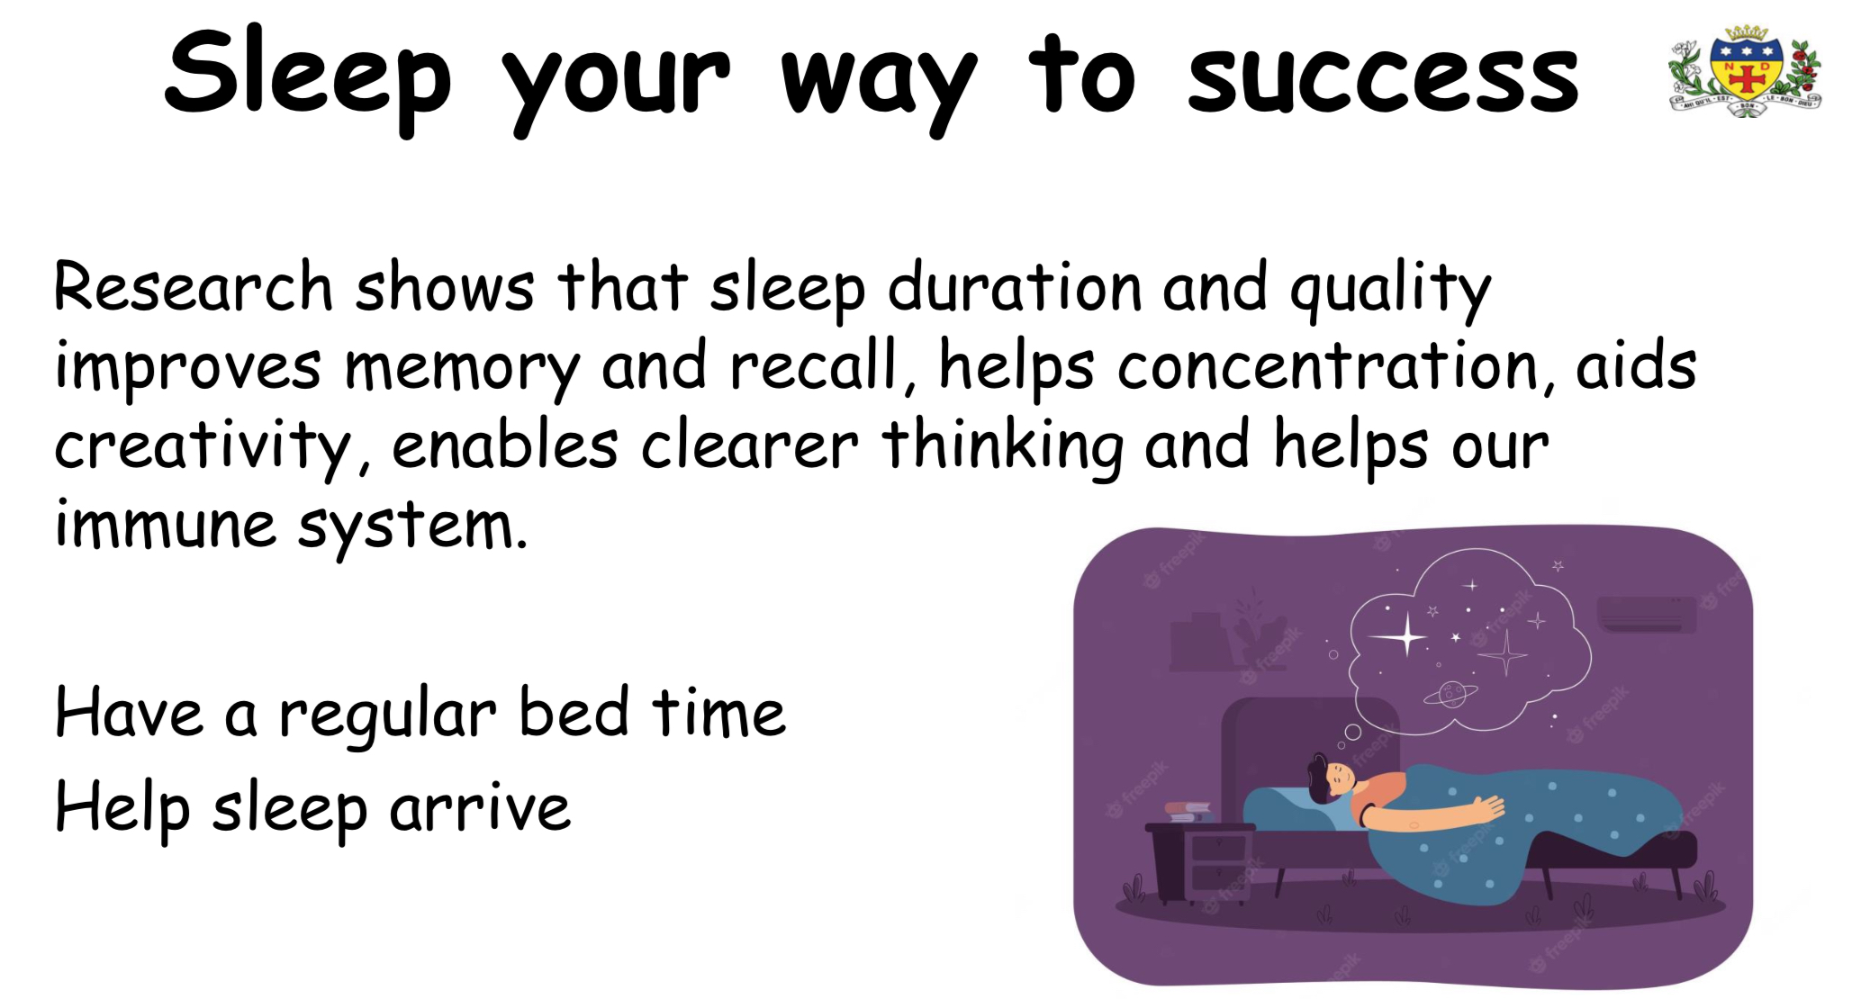


Slide 22
