Slide 1
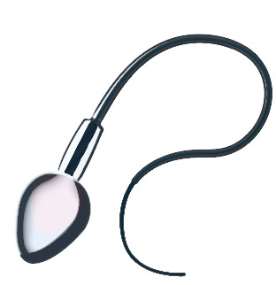
cytoplasm | site of chemical reactions in the cell | gel like substance containing enzymes to catalyse the reactions
nucleus | contains genetic material | controls the activities of the cell and codes fro proteins
cell membrane | semi permeable | controls the movement of substances in and out of the cell
ribosome | site of protein synthesis | mRNA is translated to an amino acid chain
mitochondrion | site of respiration | where energy is released for the cell to function
cell membrane | site of chemical reactions in the cell | gel like substance containing enzymes to catalyse the reactions
bacterial DNA | not in nucleus floats in the cytoplasm | controls the function of the cell
cell wall | NOT made of cellulose | supports and strengthens the cell
plasmid | small rings of DNA | contain additional genes
cytoplasm | semi permeable | controls the movement of substances in and out of the cell
animal cell
Bacterial cells are much smaller than plant and animal cells
Eukaryotes complex organisms
AQA
Cell Structure
Prokaryotes simpler organisms
plant cell
contains all the parts of animal cells plus extras
nerve |  | carry electrical signals | long branched connections and insulating sheath
sperm |  | fertilise an egg | streamlined with a long tail acrosome containing enzymes large number of mitochondria
muscle |  | contract to allow movement | contains a large number of mitochondria long
permanent vacuole | contains cell sap | keeps cell turgid, contains sugars and salts in solution
cell wall | made of cellulose | supports and strengthens the cell
chloroplast | site of photosynthesis | contains chlorophyll, absorbs light energy
specialised animal cells
Specialised cells
how a cell changes and becomes specialised
Undifferentiated call are called STEM cells
Cell differentiation
root hair |  | absorb water and minerals from soil | hair like projections to increase the surface area
xylem |  | carry water and minerals | TRANSPIRATION - dead cells cell walls toughened by lignin flows in one direction
phloem |  | carry glucose | TRANSLOCATION - living cells cells have end plates with holes flows in both directions
animal cell differentiation
plant cell differentiation
Microscopy
specialised plant cells
early stages of development
only for repair and replacement
all stages of life cycle the stem cells are grouped together in meristems
Feature | Light (optical) microscope | Electron microscope
Radiation used | Light rays | Electron beams
Max magnification | ~ 1500 times | ~ 2 000 000 times
Resolution | 200nm | 0.2nm
Size of microscope | Small and portable | Very large and not portable
Cost | ~£100 for a school one | Several £100,000 to £1 million plus
PREFIXES
Prefix | Multiple | Standard form
centi (cm) | 1 cm = 0.01 m | x 10 ⁻²
milli (mm) | 1 mm = 0.001 m | x 10 ⁻³
micro (𝛍m) | 1 𝛍m = 0.000 001 m | x 10 ⁻⁶
nano (nm) | 1nm = 0.000 000 001 m | x 10 ⁻⁹

Slide 2
cell | The smallest structural and functional unit of an organism.
nucleus | A structure that contains genetic material and controls the activities of the cell.
chromosome | A thread like structure of coiled DNA found in the nucleus of eukaryotic cells.
DNA | A polymer made up of two strands forming a double helix.
gene | A section of DNA that codes for a specific protein or characteristic.
Small intestines | Villi – increase surface area, Good blood supply – to maintain concentration gradient, Thin membranes – short diffusion distance.
Lungs | Alveoli– increase surface area, Good blood supply – to maintain concentration gradient, Thin membranes – short diffusion distance.
Gills in fish | Gill filaments and lamella – increase surface area, Good blood supply – to maintain concentration gradient, Thin membranes – short diffusion distance.
Roots | Root hair cells - increase surface area.
Leaves | Large surface area, thin leaves for short diffusion path, stomata on the lower surface to let O₂ and CO₂ in and out.
smallest largest
ADAPTATIONS FOR DIFFUSSION
The greater the difference in concentrations the faster the rate of diffusion.
AQA
Cell Biology 2
Diffusion No energy required | Movement of particles in a solution or gas from a higher to a lower concentration | E.g. O₂ and CO₂ in gas exchange, urea in kidneys. Factors that affect the rate are concentration, temperature and surface area.
Osmosis No energy required | Movement of water from a dilute solution to a more concentrated solution | E.g. Plants absorb water from the soil by osmosis through their root hair cells. Plants use water for several vital processes including photosynthesis and transporting minerals.
Active transport ENERGY required | Movement of particles from a dilute solution to a more concentrated solution | E.g. movement of mineral ions into roots of plants and the movement of glucose into the small intestines.
Cells divide in a series of stages. The genetic material is doubled and then divided into two identical cells.
MITOSIS AND THE CELL CYCLE
Cell division
STEM CELLS
Stage 1 | Growth | Increase the number of sub-cellular structures e.g. ribosomes and mitochondria.
Stage 2 | DNA Synthesis | DNA replicates to form two copies of each chromosome.
Stage 3 | Mitosis | One set of chromosomes is pulled to each end of the cell and the nucleus divides. Then the cytoplasm and cell membranes divide to form two cells that are identical to the parent cell.
Transport in cells
Undifferentiated cell of an organism
Divides to form more cells of the same type, and can differentiate to form many other cell types.
Human Embryonic stem cells | Can be cloned and made to differentiate into most cell types | Therapeutic cloning uses same genes so the body does not reject the tissue. Can be a risk of infection
Adult bone marrow stem cells | Can form many types of human cells e.g. blood cells | Tissue is matched to avoid rejection, risk of infection. Only a few types of cells can be formed.
Meristems (plants) | Can differentiate into any plant cell type throughout the life of the pant. | Used to produce clones quickly and economically, e.g. rare species, crop plants with pest /disease resisitance
Mitosis occurs during growth, repair, replacement of cells. Asexual reproduction occurs by mitosis in both plants
& simple animals.
Treatment with stem cells may be able to help conditions such as diabetes and paralysis. Some people object to the use of stem cells on ethical or religious grounds

Slide 3
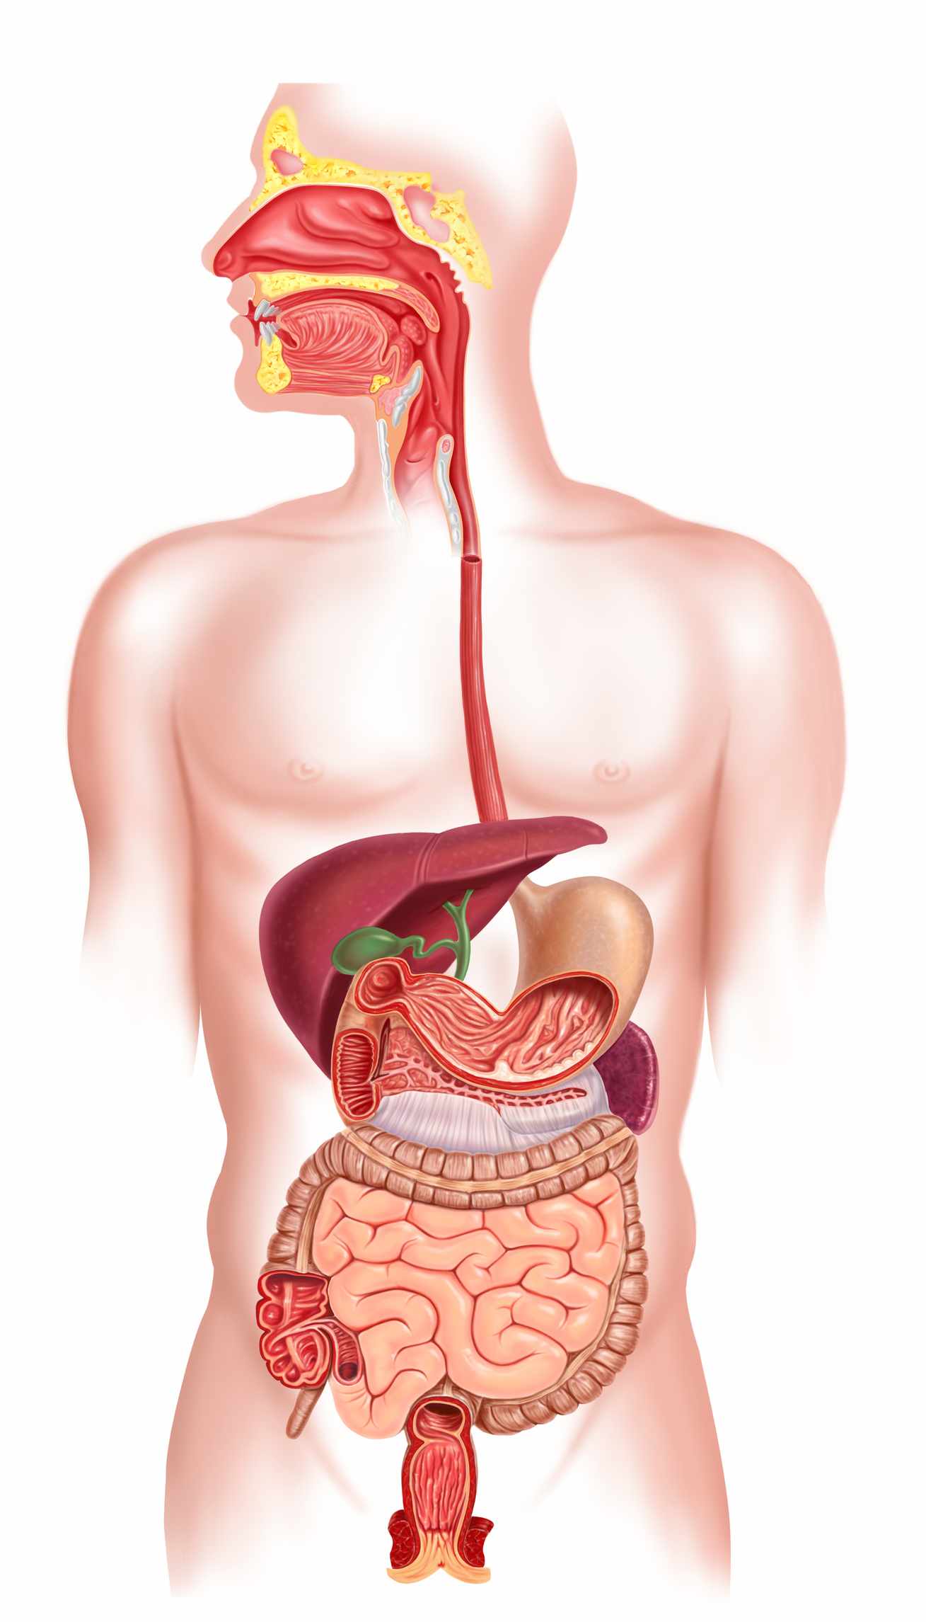
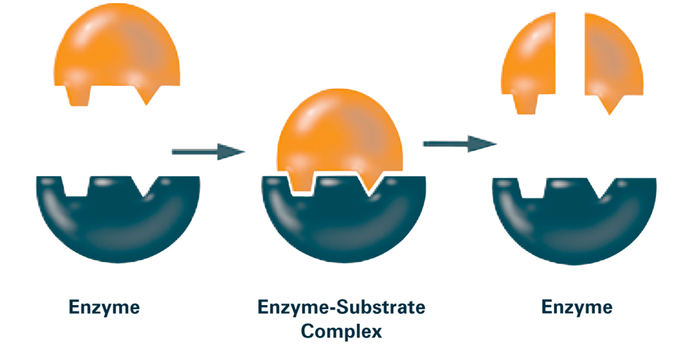
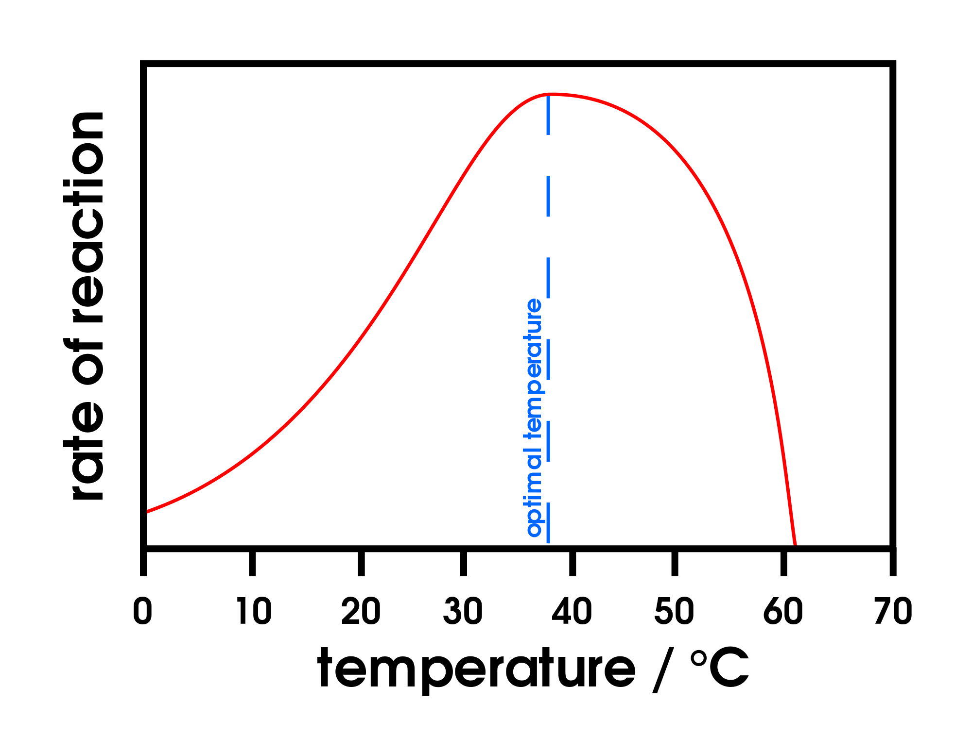
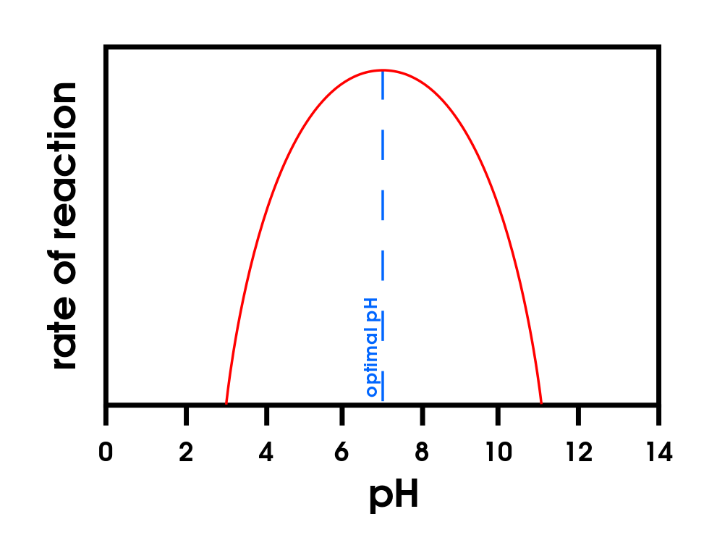

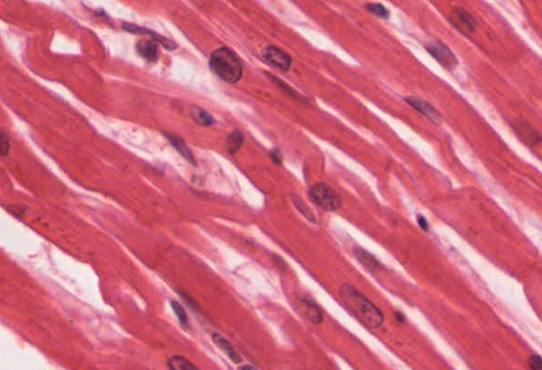
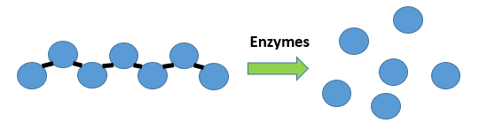
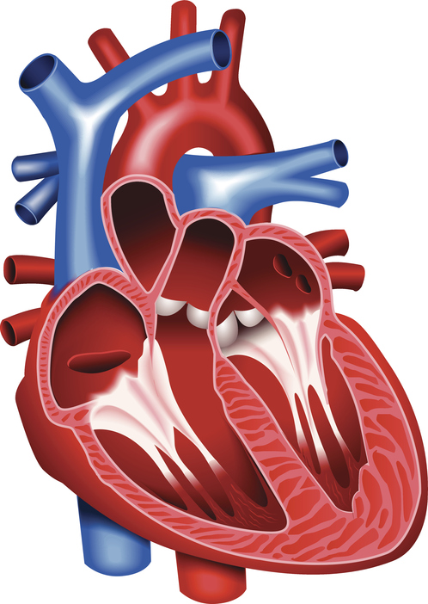
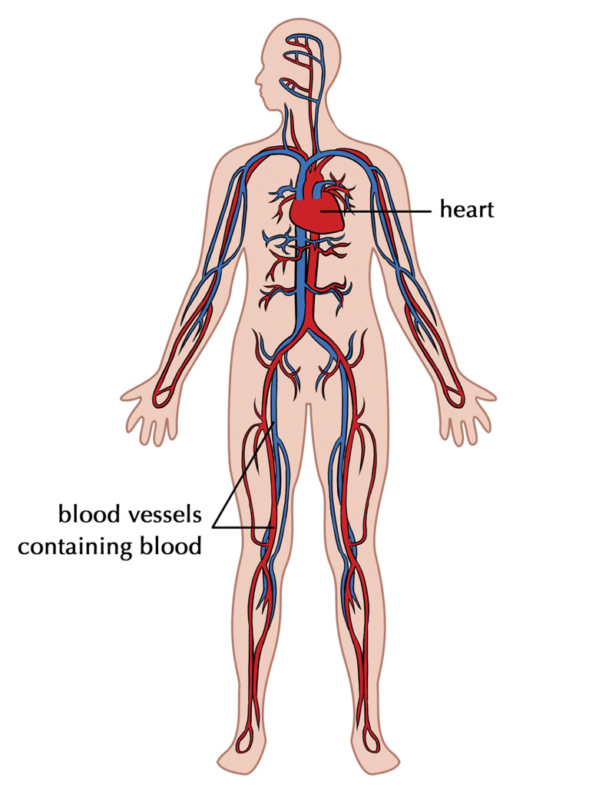
Enzymes catalyse (increase the rate of) specific reactions in living organisms
An organ system in which organs work together to digest and absorb food.
The ‘lock and key theory’ is a simplified model to explain enzyme action
Enzymes catalyse specific reactions in living organisms due to the shape of their active site
Enzymes in digestion
The activity of enzymes is affected by changes in temperature and pH
Enzymes activity has an optimum temperature | Enzyme activity has an optimum pH
More energy consumed in food and drink than used
obesity
Linked to increased rates of cardiovascular disease and development of diabetes type 2.
mouth
oesophagus
The human digestive system
Non-communicable diseases
liver
stomach
gall bladder
pancreas
small intestines
large intestines
Digestive enzymes speed up the conversion of large insoluble molecules (food) into small soluble molecules that can be absorbed into the bloodstream
Large changes in temperature or pH can stop the enzyme from working (denature)
Temperature too high | pH too high or too low
Enzyme changes shape (denatures) the substrate no longer fits the active site.
AQA GCSE
ORGANISATION Part 1
anus
Food tests
Sugars (glucose) | Benedicts’ test | Orange to brick red precipitate.
Starch | Iodine test | Turns black.
Biuret | Biuret reagent | Mauve or purple solution.
Principles of organisation
Carbohydrases (e.g. amylase) |  | Made in salivary glands, pancreas, small intestine | Break down carbohydrates to simple sugar (e.g. amylase breaks down starch to glucose).
Proteases |  | Made in stomach, pancreas | Break down protein to amino acids.
Lipases |  | Made in pancreas (works in small intestine) | Break down lipids (fats) to glycerol and fatty acids).
Bile (not an enzyme) |  | Made in liver, stored in gall bladder. | Emulsifies lipids to increase surface area to increase the rate of lipid break down by lipase. Changes pH to neutral for lipase to work
Cells |  | e.g. muscle cells | The basic building blocks of all living organisms.
Tissues |  | e.g. muscle tissue | A group of cells with a similar structure and function.
Organs |  | e.g. the heart | Aggregations (working together) of tissues performing a specific function.
Organ systems |  | e.g. the circulatory system | Organs working together to form organ systems, which work together to form an organism.
Cells, tissues, organs and systems
The products of digestion are used to build new carbohydrates, lipids and proteins. Some glucose is used for respiration.

Slide 4
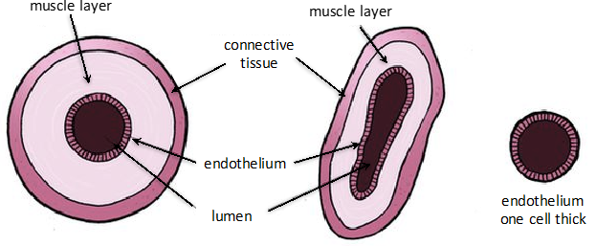
Blood vessels
The heart is an organ that pumps blood around the body in a double circulatory system
Different structure in the heart have different functions | Right ventricle | Pumps blood to the lungs where gas exchange takes place.
 | Left ventricle | Pumps blood around the rest of the body.
 | Pacemaker (in the right atrium) | Controls the natural resting heart rate. Artificial electrical pacemakers can be fitted to correct irregularities.
 | Coronary arteries | Carry oxygenated blood to the cardiac muscle.
 | Heart valves | Prevent blood in the heart from flowing in the wrong direction.
Artery | Vein | Capillary
Carry blood away from the heart | Carry blood to the heart | Connects arteries and veins
Thick muscular walls, small lumen, carry blood under high pressure, carry oxygenated blood (except for the pulmonary artery). | Thin walls, large lumen, carry blood under low pressure, have valves to stop flow in the wrong direction, carry deoxygenated blood (except for the pulmonary vein). | One cell thick to allow diffusion, Carry blood under very low pressure.
Heart
Blood
AQA GCSE
ORGANISATION part 2
Lungs and gas exchange
Blood is a tissue consisting of plasma, in which blood cells, white blood cells and platelets are suspended
The heart pumps low oxygen/high carbon dioxide blood to the lungs
Plasma (55%) | Pale yellow fluid | Transports CO₂, hormones and waste.
Red blood cells (45%) | Carries oxygen | Large surface area, no nucleus, full of haemoglobin.
White blood cells (<1%) | Part of the immune system | Some produce antibodies, others surround and engulf pathogens.
Platelets (<1%) | Fragments of cells | Clump together to form blood clots.
Trachea | Carries air to/from the lungs | Rings of cartilage protect the airway.
Bronchioles | Carries air to/from the air sacs (alveoli) | Splits into multiple pathways to reach all the air sacs.
Alveoli | Site of gas exchange in the lungs | Maximises surface area for efficient gas exchange.
Capillaries | Allows gas exchange between into/out of blood | Oxygen diffuses into the blood and carbon dioxide diffuses out.

Slide 5
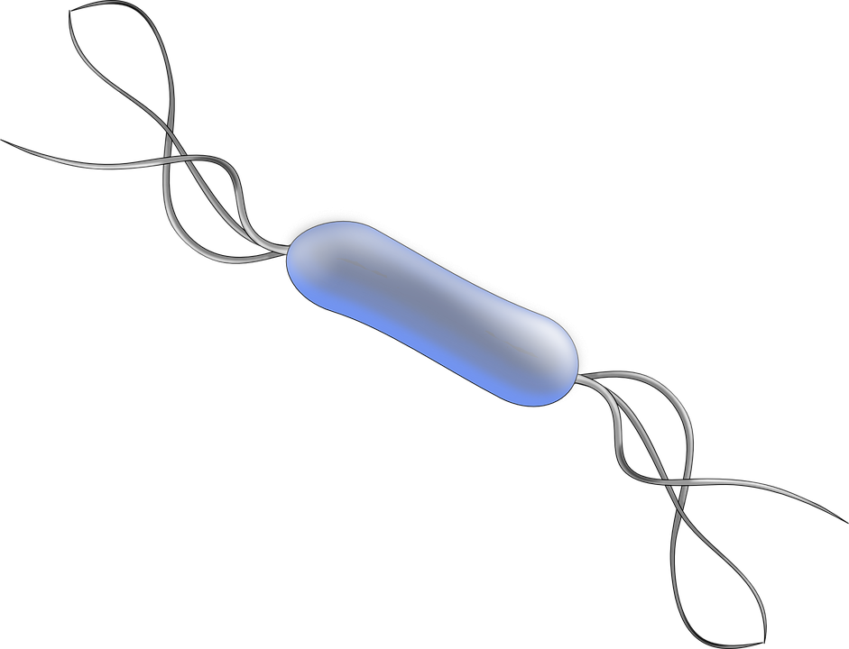
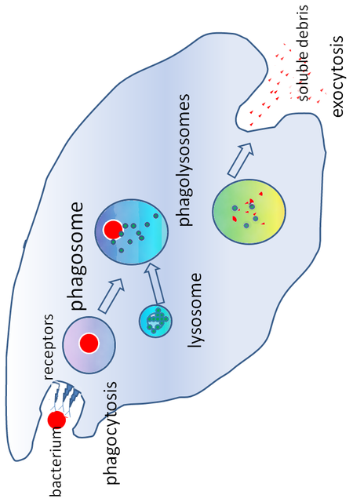
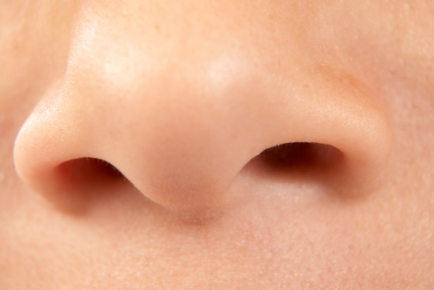
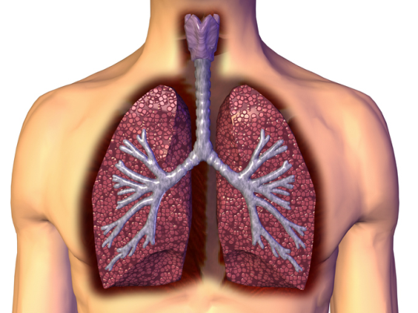
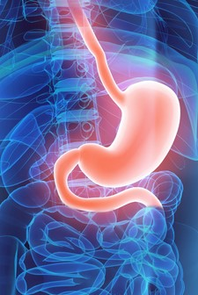
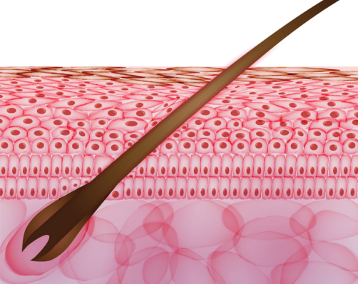
Phagocytes | Phagocytosis | Phagocytes engulf the pathogens and digest them.
Lymphocytes | Antibody production | Specific antibodies destroy the pathogen. This takes time so an infection can occur. If a person is infected again by the same pathogen, the lymphocytes make antibodies much faster.
 | Antitoxin production | Antitoxin is a type of antibody produced to counteract the toxins produced by bacteria.
Antigens (surface protein)
Pathogens are identified by white blood cells by the different proteins on their surfaces ANTIGENS.
The human body has several non specific ways of defending itself from pathogens getting in |  | Nose | Nasal hairs, sticky mucus and cilia prevent pathogens entering through the nostrils.
 |  | Trachea and bronchus (respiratory system) | Lined with mucus to trap dust and pathogens. Cilia move the mucus upwards to be swallowed.
 |  | Stomach acid | Stomach acid (pH1) kills most ingested pathogens.
 |  | Skin | Hard to penetrate waterproof barrier. Glands secrete oil which kill microbes
White blood cells are part of the immune system
Immune system
Detection and identification of plant diseases (bio only) | Detection | Identification
 | Stunted growth | Reference using gardening manual or website, laboratory test for pathogens, testing kit using monoclonal antibodies.
 | Spots on leaves
 | Area of decay
 | growths
 | Malformed stem/leaves
 | Discolouration
 | Presence of pests
AQA GCSE INFECTION AND RESPONSE part 1
Non-specific defence systems
Human defence systems
Plants have several ways of defending themselves from pathogens and animals
Physical | Mechanical
Thick waxy layers, cell walls stop pathogen entry | Thorns, curling up leaves to prevent being eaten
Chemical
Antibacterial and toxins made by plant
Pathogens may infect plants or animals and can be spread by direct contact, water or air
Pathogen | Disease | Symptoms | Method of transmission | Control of spread
Virus | Measles | Fever, red skin rash. | Droplet infection from sneezes and coughs. | Vaccination as a child.
Virus | HIV | Initially flu like systems, serious damage to immune system. | Sexual contact and exchange of body fluids. | Anti-retroviral drugs and use of condoms.
Virus | Tobacco mosaic virus | Mosaic pattern on leaves. | Enters via wounds in epidermis caused by pests. | Remove infected leaves and control pests that damage the leaves.
Bacteria | Salmonella | Fever, cramp, vomiting, diarrhoea. | Food prepared in unhygienic conditions or not cooked properly. | Improve food hygiene, wash hands, vaccinate poultry, cook food thoroughly.
Bacteria | Gonorrhoea | Green discharge from penis or vagina. | Direct sexual contact or exchange of body fluids. | Use condoms. Treatment using antibiotics.
Protists | Malaria | Recurrent fever. | By an animal vector (mosquitoes). | Prevent breeding of mosquitoes. Use of nets to prevent bites.
Fungus | Rose black spot | Purple black spots on leaves. | Spores carried via wind or water. | Remove infected leaves. Spray with fungicide.
Nitrate ions needed for protein synthesis – lack of nitrate = stunted growth.
Magnesium ions needed to make chlorophyll – not enough leads to chlorosis – leaves turn yellow.
Bacteria may produce toxins that damage tissues and make us fell ill
Viruses | Bacteria (prokaryotes) | Protists (eukaryotes) | Fungi (eukaryotes)
e.g. cold, influenza, measles, HIV, tobacco mosaic virus | e.g. tuberculosis (TB), Salmonella, Gonorrhoea | e.g. dysentery, sleeping sickness, malaria | e.g. athlete’s foot, thrush, rose black spot
DNA or RNA surrounded by a protein coat | No membrane bound organelles (no chloroplasts, mitochondria or nucleus). Cell wall. Single celled organisms | Membrane bound organelles. Usually single celled. | Membrane bound organelles, cell wall made of chitin. Single celled or multi-cellular
Communicable diseases
Pathogens are microorganisms that cause infectious disease
Pathogens
Viruses live and reproduce inside cells causing damage

Slide 6
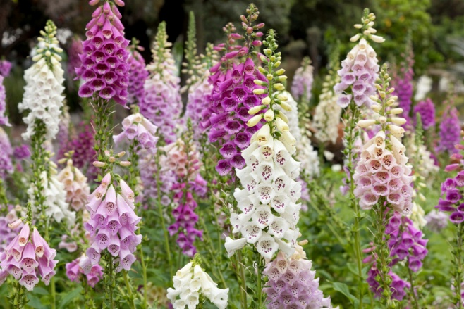
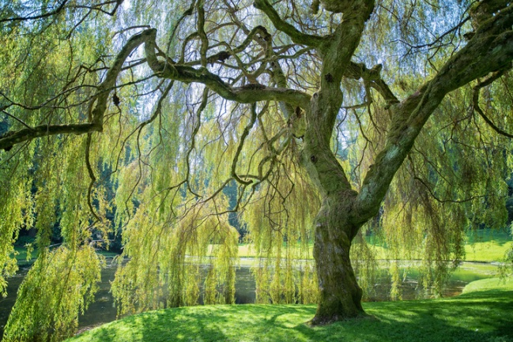
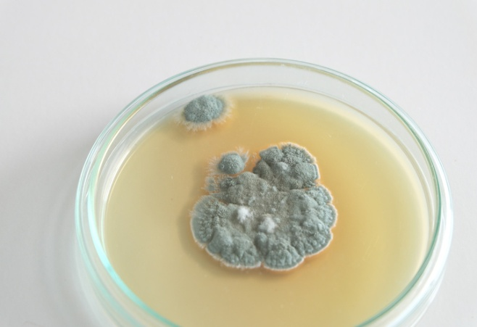
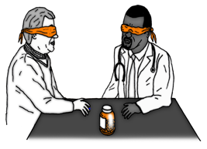
Traditionally drugs were extracted from plants and microorganisms
Digitalis | Aspirin | Penicillin
Extracted from foxglove plants and used as a heart drug | A painkiller and anti-inflammatory that was first found in willow bark | Discovered by Alexander Fleming from the Penicillium mould and used as an antibiotic
Antibiotics and painkillers
Antibiotics have greatly reduced deaths from infectious bacterial disease
antibiotics | e.g. penicillin | Kill infective bacteria inside the body. Specific bacterial infections require specific antibiotics.
Painkillers and other medicines | e.g. aspirin, paracetamol, ibuprofen | Drugs that are used to treat the symptoms of a disease. They do not kill pathogens
Antibiotics cannot be use to treat viral pathogens
Bacteria can mutate
Most new drugs are synthesised by chemists in the pharmaceutical industry.
Sometimes this makes them resistant to antibiotic drugs.
It is difficult to develop drugs to kill viruses without harming body tissues because viruses live and reproduce inside cells
Discovery and drug development
AQA
INFECTION AND RESPONSE
Vaccination
Drugs have to be tested and trialled before to check they are safe and effective
Used to immunise a large proportion of the population to prevent the spread of a pathogen
New drugs are extensively tested for: | Efficacy | Make sure the drug works
 | Toxicity | Check that the drug is not poisonous
 | Dose | The most suitable amount to take
Vaccination | Small amount of dead or inactive form of the pathogen | 1st infection by pathogen | White blood cells detect pathogens in the vaccine. Antibodies are released into the blood.
 |  | Re-infection by the same pathogen | White blood cells detect pathogens. Antibodies are made much faster and in larger amounts.
A person is unlikely to suffer the symptoms of the harmful disease and it’s spread in a population is prevented
Preclinical trials - using cells, tissues and live animals - must be carried out before the drug can be tested on humans.
Double blind trial: patients and scientists do not know who receives the new drug or placebo until the end of the trial. This avoids bias.
Clinical trials use healthy volunteers and patients
Created more side effects than expected (fatal in some cases) and are not as widely used as everybody hoped when first developed.
Stage 1 | Stage 2 | Stage 3 | Stage 4
Healthy volunteers try small dose of the drug to check it is safe record any side effects | A small number of patients try the drug at a low dose to see if it works | A larger number of patients; different doses are trialled to find the optimum dose | A double blind trial will occur. The patients are divided into groups. Some will be given the drug and some a placebo.
A placebo can look identical to the new drug but contain no active ingredients
Monoclonal antibodies can be used in a variety of ways
Diagnosis | Detecting pathogens | Detecting molecules | Treatment
e.g. pregnancy test – measure the level of hormones | Can detect very small quantities of chemicals in the blood | Fluorescent dye can be attached so it can be seen inside cells or tissues | Bound to radioactive substance, toxic drug or chemical Cancer cells are targeted to normal body cells are unharmed
Monoclonal antibodies | Identical copies of one types of antibody produced in laboratory | 1. A mouse is injected with pathogen
 |  | 2. Lymphocytes produce antibodies
 |  | 3. Lymphocytes are removed from the mouse and fused with rapidly dividing mouse tumour cells
 |  | 4. The new cells are called hybridomas
 |  | 5. The hybridomas divide rapidly and release lots of antibodies which are then collected
Monoclonal antibodies (Biology only HT)
Specific to one binding site on the antigen. Can target specific chemicals or cells in the body

Slide 7
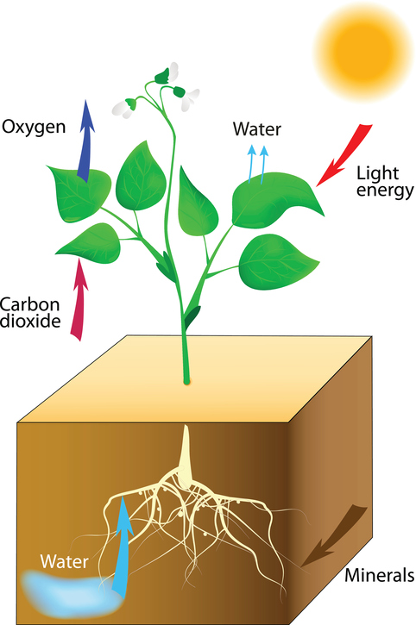
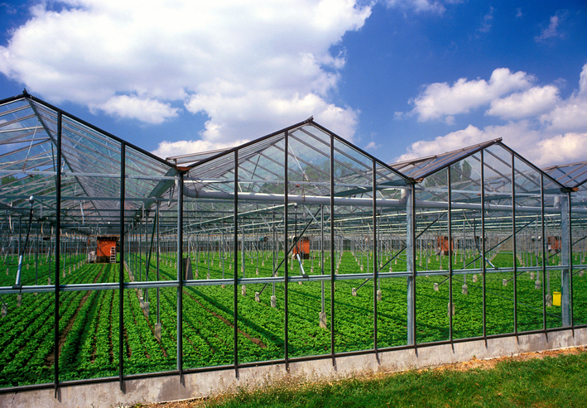
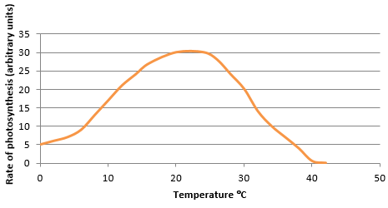
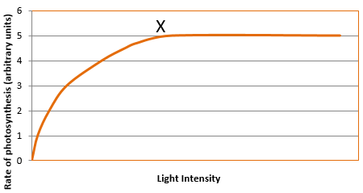
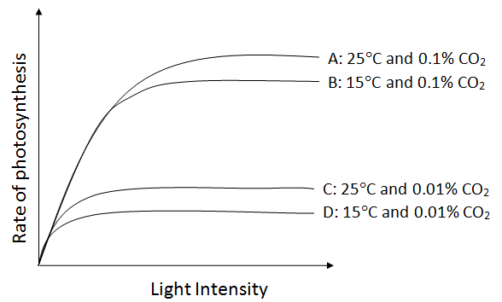
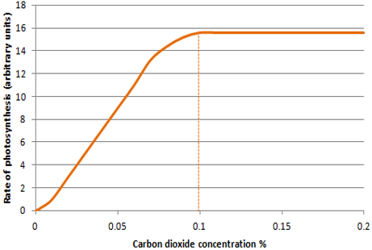
Respiration, stored as insoluble starch, fats or oils for storage, cellulose for cell walls, combine with nitrates from the soil to form amino acids for protein synthesis
Control conditions in greenhouses to reduce limiting factors can improve crop yields | Heating | Used to provide optimum temperatures for maximum plant growth.
 | Artificial lighting | Enhances the natural sunlight especially overnight and on cloudy days.
 | Extra carbon dioxide | Gas can be pumped into the air inside the greenhouse.
Growers must balance the economics of additional costs of controlling the conditions to maximise photosynthesis with making a profit.
permanent vacuole
Plants use the glucose produced in photosynthesis in a variety of ways
nucleus
chloroplasts
cytoplasm
cell membrane
cell wall
Photosynthetic reaction
The plant manufactures glucose from carbon dioxide and water using energy transferred from the environment to the chloroplasts by light
Photosynthesis | Plants make use of light energy from the environment (ENDOTHERMIC) to make food (glucose) | Carbon dioxide + Water Oxygen + Glucose
 |  | CO₂ + H₂O O₂ + C₆H₁₂O₆
AQA GCSE BIOENERGETICS part 1
light
Rate of photosynthesis
Rate of photosynthesis HT Only
light
Graph lines C and D: If temperature is increased by 10ºC then a slight increase in rate of photosynthesis occurs.
The rate of photosynthesis is affected by temperature, light intensity, carbon dioxide concentration, and the amount of chlorophyll
Explain graphs of two or three factors and decide which is the limiting factor
Factors affecting the rate of photosynthesis | Factor | How the rate is affected | Limiting factors (why the rate stops going up)
 | Temperature | As the temperature of the environment the plant is in increases rate of photosynthesis increases (up to a point) as there is more energy for the chemical reaction. | Photosynthesis is an enzyme controlled reaction. If the temperature increases too much, then the enzymes become denatured and the rate of reaction will decrease and stop
 | Light intensity | Light intensity increases as the distance between the plant and the light sources increases. As light intensity increases so does the rate of photosynthesis (up to a point) as more energy is available for the chemical reaction. | At point X another factor is limiting the rate of photosynthesis. This could be carbon dioxide concentration, temperature or the amount of chlorophyll
 | Carbon dioxide concentration | Carbon dioxide is needed for plants to make glucose. The rate of photosynthesis will increase when a plant is given higher concentrations of carbon dioxide (up to a point). | At point X another factor is limiting the rate of photosynthesis. This could be light intensity, temperature or the amount of chlorophyll
 | Amount of chlorophyll | Chlorophyll is a photosynthetic pigment that absorbs light and allows the reaction between water and carbon dioxide to occur (photosynthesis) | Another factor could limit the rate of photosynthesis. This could be light intensity, temperature or the carbon dioxide concentration
Graph Lines A and B: If carbon dioxide concentration is increased from 0.01% to 0.1% then a large increase in rate occurs up to a point.
Graph lines A and D: If carbon dioxide concentration and temperature are increased the rate of photosynthesis increases significantly up to a point.
Light intensity obeys the inverse square law. This means that if you double the distance between the plant and the light source you quarter the light intensity
x
Graph line A: Rate could be limited by temperature and/or amount of chlorophyll. Plant tissue can be damaged when carbon dioxide concentrations exceed 0.1%

Slide 8
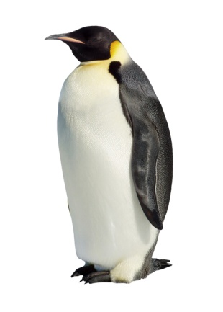
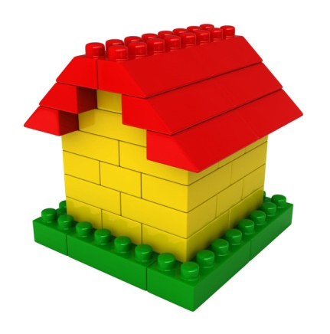

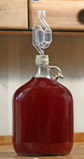
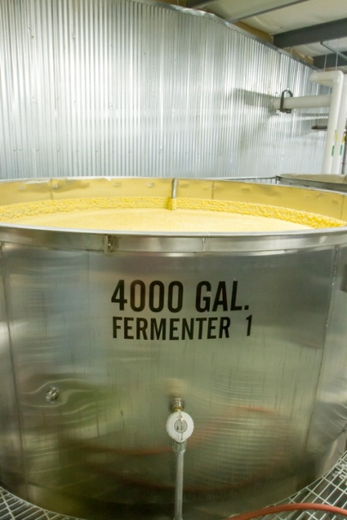
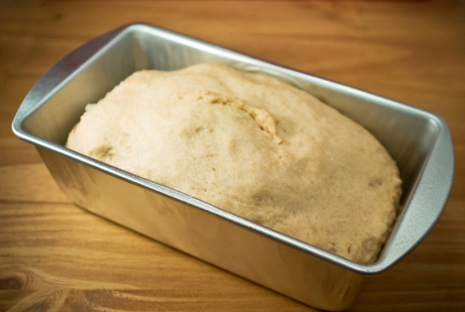
An organism will receive all the energy it needs for living processes as a result of the energy transferred from respiration | For movement |  | To enable muscles to contract in animals.
 | For keeping warm |  | To keep a steady body temperature in a cold environment.
 | For chemical reactions |  | To build larger molecules from smaller one.
During long periods of vigorous activity muscles become fatigued and stop contracting efficiently
cytoplasm
mitochondria
Electron micrograph of a mitochondrion
animal cell
plant cell
Response to exercise
Respiration
Anaerobic respiration
Respiration when oxygen is in short supply. Occurs during intensive exercise
During hard exercise, muscle cells are respiring so fast that blood cannot transport enough oxygen to meet their needs. Glucose is partially oxidised to produce lactic acid which builds up in muscle tissue causing them to become painful and fatigued.
glucose lactic acid
Aerobic respiration
Respiration with oxygen. Occurs inside the mitochondria continuously
Glucose is oxidised by oxygen to transfer the energy the organism needs to perform it’s functions.
C₆H₁₂O₆ + O₂ CO₂ + H₂O | glucose + oxygen carbon dioxide + water
During exercise the human body reacts to increased demand for energy | Heart rate increases | Top pump oxygenated blood faster to the muscle tissues and cells.
 | Breathing rate and breath volume increase | This increases the amount of oxygen entering the blood stream.
AQA GCSE BIOENERGETICS part 2
Cellular respiration is an exothermic reaction which is continuously occurring in all living cells
Metabolism is the sum of all the reactions in a cell or the body
Metabolism
Metabolism | The energy transferred by respiration in cells is used by the organism for the continual enzyme controlled processes of metabolism. | Conversion of glucose to starch, glycogen and cellulose.
 |  | The formation of lipid molecules from a molecule of glycerol and three molecules of fatty acid.
 |  | The use of glucose and nitrate ions to form amino acids which in turn are used to synthesise proteins.
 |  | Respiration
 |  | Breakdown of excess proteins to form urea for excretion.
Anaerobic respiration in plant and yeast cells
The end products are ethanol and carbon dioxide. Anaerobic respiration in yeast cells is called fermentation
glucose ethanol + carbon dioxide
This process is economically important in the manufacture of alcoholic drinks and bread.
Anaerobic respiration releases a much smaller amount of energy than aerobic respiration.
The extra amount of oxygen required to remove all lactic acids from cells is called the oxygen debt
Lactic acid builds up in the muscles cells during exercise
Blood flows through the muscle cells and transports the lactic acid to the liver
The liver oxidises the lactic acid and converts it back to glucose
Response to exercise HT only
The incomplete oxidation of glucose causes a build up of lactic acid and creates an oxygen debt
Aerobic respiration releases a large amount of energy from each glucose molecule

