Slide 1
Atom | The smallest part of an element that can exist | Have a radius of around 0.1 nanometres and have no charge (0).
Element | Contains only one type of atom | Around 100 different elements each one is represented by a symbol e.g. O, Na, Br.
Compound | Two or more elements chemically combined | Compounds can only be separated into elements by chemical reactions.
Pre 1900 |  | Tiny solid spheres that could not be divided | Before the discovery of the electron, John Dalton said the solid sphere made up the different elements.
1897 ‘plum pudding’ |  | A ball of positive charge with negative electrons embedded in it | JJ Thompson ‘s experiments showed that showed that an atom must contain small negative charges (discovery of electrons).
1909 nuclear model |  | Positively charge nucleus at the centre surrounded negative electrons | Ernest Rutherford's alpha particle scattering experiment showed that the mass was concentrated at the centre of the atom.
1913 Bohr model |  | Electrons orbit the nucleus at specific distances | Niels Bohr proposed that electrons orbited in fixed shells; this was supported by experimental observations.
Atoms, elements and compounds
Central nucleus | Contains protons and neutrons
Electron shells | Contains electrons
Electronic shell | Max number of electrons
1 | 2
2 | 8
3 | 8
4 | 2
Name of Particle | Relative Charge | Relative Mass
Proton | +1 | 1
Neutron | 0 | 1
Electron | -1 | Very small
Electronic structures
The development of the model of the atom
James Chadwick | Provided the evidence to show the existence of neutrons within the nucleus
AQA GCSE
Atomic structure and periodic table part 1
Rutherford's scattering experiment | A beam of alpha particles are directed at a very thin gold foil | Most of the alpha particles passed right through. A few (+) alpha particles were deflected by the positive nucleus. A tiny number of particles reflected back from the nucleus.
Relative electrical charges of subatomic particles
7
Li
3
Mass number | The sum of the protons and neutrons in the nucleus
Atomic number | The number of protons in the atom | Number of electrons = number of protons
Mixtures | Two or more elements or compounds not chemically combined together | Can be separated by physical processes.
Chemical equations | Show chemical reactions - need reactant(s) and product(s) energy always involves and energy change | Law of conservation of mass states the total mass of products = the total mass of reactants.
Method | Description | Example
Filtration | Separating an insoluble solid from a liquid | To get sand from a mixture of sand, salt and water.
Crystallisation | To separate a solid from a solution | To obtain pure crystals of sodium chloride from salt water.
Simple distillation | To separate a solvent from a solution | To get pure water from salt water.
Fractional distillation | Separating a mixture of liquids each with different boiling points | To separate the different compounds in crude oil.
Chromatography | Separating substances that move at different rates through a medium | To separate out the dyes in food colouring.
Word equations | Uses words to show reaction reactants → products magnesium + oxygen → magnesium oxide | Does not show what is happening to the atoms or the number of atoms.
Symbol equations | Uses symbols to show reaction reactants → products 2Mg + O₂ → 2MgO | Shows the number of atoms and molecules in the reaction, these need to be balanced.
Isotopes | Atoms of the same element with the same number of protons and different numbers of neutrons | ³⁵Cl (75%) and ³⁷Cl (25%) Relative abundance = (% isotope 1 x mass isotope 1) + (% isotope 2 x mass isotope 2) ÷ 100 e.g. (25 x 37) + (75x 35) ÷ 100 = 35.5
Relative atomic mass

Slide 2
Alkali metals
Halogens
Noble gases
Elements arranged in order of atomic number | Elements with similar properties are in columns called groups | Elements in the same group have the same number of outer shell electrons and elements in the same period (row) have the same number of electron shells.
1
2
3
4
5
6
7
0
H
Transition metals
He
Li
Be
B
C
N
O
F
Ne
Before discovery of protons, neutrons and electrons | Elements arranged in order of atomic weight | Early periodic tables were incomplete, some elements were placed in inappropriate groups if the strict order atomic weights was followed.
Mendeleev | Left gaps for elements that hadn’t been discovered yet | Elements with properties predicted by Mendeleev were discovered and filled in the gaps. Knowledge of isotopes explained why order based on atomic weights was not always correct.
Na
Mg
Al
Si
P
S
Cl
Ar
The Periodic table
K
Ca
Sc
Ti
V
Cr
Mn
Fe
Co
Ni
Cu
Zn
Ga
Ge
As
Se
Br
Kr
Rb
Sr
Y
Zr
Nb
Mo
Tc
Ru
Rh
Pd
Ag
Cd
In
Sn
Sb
Te
I
Xe
Cs
Ba
La
Hf
Ta
W
Re
Os
Ir
Pt
Au
Hg
Tl
Pb
Bi
Po
At
Rn
Development
of the Periodic table
Fr
Ra
Ac
Rf
Db
Sg
Bh
Hs
Mt
?
?
?
Metals to the left of this line, non metals to the right
Metals | To the left of the Periodic table | Form positive ions. Conductors, high melting and boiling points, ductile, malleable.
Non metals | To the right of the Periodic table | Form negative ions. Insulators, low melting and boiling points.
Metals and non metals
Alkali metals | Very reactive with oxygen, water and chlorine | Only have one electron in their outer shell. Form +1 ions.
 | Reactivity increases down the group | Negative outer electron is further away from the positive nucleus so is more easily lost.
Group
7
AQA GCSE
Atomic structure and periodic table part 2
Group 1
Halogens | Consist of molecules made of a pair of atoms | Have seven electrons in their outer shell. Form -1 ions.
 | Melting and boiling points increase down the group (gas → liquid → solid) | Increasing atomic mass number.
 | Reactivity decreases down the group | Increasing proton number means an electron is more easily gained
With oxygen | Forms a metal oxide | Metal + oxygen → metal oxide | e.g. 4Na + O₂ → 2Na₂O
With water | Forms a metal hydroxide and hydrogen | Metal + water → metal hydroxide + hydrogen | e.g. 2Na + 2H₂O → 2NaOH + H₂
With chlorine | Forms a metal chloride | Metal + chlorine → metal chloride | e.g. 2Na + Cl₂ → 2NaCl
Group 0
Transition metals (Chemistry only)
Noble gases | Unreactive, do not form molecules | This is due to having full outer shells of electrons.
 | Boiling points increase down the group | Increasing atomic number.
With metals | Forms a metal halide | Metal + halogen → metal halide e.g. Sodium + chlorine → sodium chloride | e.g. NaCl metal atom loses outer shell electrons and halogen gains an outer shell electron
With hydrogen | Forms a hydrogen halide | Hydrogen + halogen → hydrogen halide e.g. Hydrogen + bromine → hydrogen bromide | e.g. Cl₂ + H₂ → 2HCl
With aqueous solution of a halide salt | A more reactive halogen will displace the less reactive halogen from the salt | Chlorine + potassium bromide → potassium chloride + bromine | e.g. Cl₂ +2KBr →2KCl + Br₂
Compared to group 1 | Less reactive Harder Denser Higher melting points | Cu²⁺ is blue Ni²⁺ is pale green, used in the manufacture of margarine Fe²⁺ is green, used in the Haber process Fe³⁺ is reddish-brown Mn²⁺ is pale pink
Typical properties | Many have different ion possibilities with different charges Used as catalysts Form coloured compounds

Slide 3
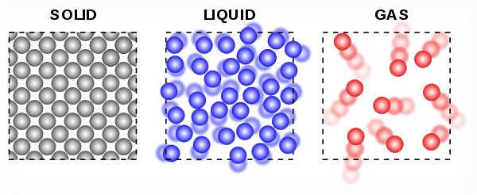
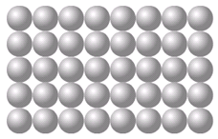
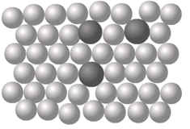
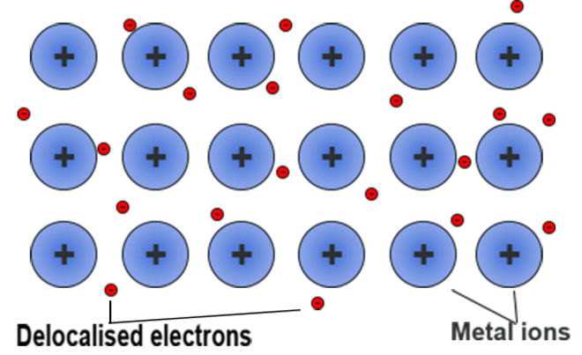
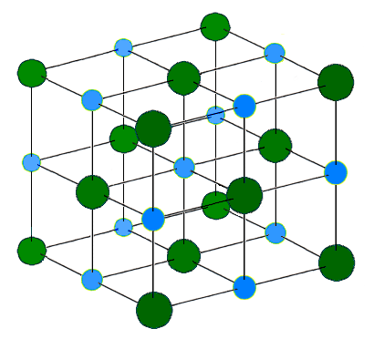
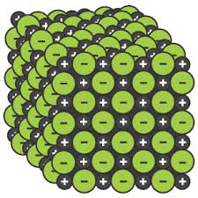
Ionic | Particles are oppositely charged ions | Occurs in compounds formed from metals combined with non metals.
Covalent | Particles are atoms that share pairs of electrons | Occurs in most non metallic elements and in compounds of non metals.
Metallic | Particles are atoms which share delocalised electrons | Occurs in metallic elements and alloys.
Solid, liquid, gas | Melting and freezing happen at melting point, boiling and condensing happen at boiling point. | The amount of energy needed for a state change depends on the strength of forces between particles in the substance. | (HT only) Limitations of simple model: There are no forces in the model All particles are shown as spheres Spheres are solid
s | solid
l | liquid
g | gas
High melting and boiling points | Large amounts of energy needed to break the bonds.
Do not conduct electricity when solid | Ions are held in a fixed position in the lattice and cannot move.
Do conduct electricity when molten or dissolved | Lattice breaks apart and the ions are free to move.
Good conductors of electricity | Delocalised electrons carry electrical charge through the metal.
Good conductors of thermal energy | Energy is transferred by the delocalised electrons.
Chemical bonds
The three states of matter
High melting and boiling points | This is due to the strong metallic bonds.
Pure metals can be bent and shaped | Atoms are arranged in layers that can slide over each other.
Properties of ionic compounds
AQA
BONDING, STRUCTURE AND THE PROPERTIES OF MATTER 1
Metals as conductors
Alloys | Mixture of two or more elements at least one of which is a metal | Harder than pure metals because atoms of different sizes disrupt the layers so they cannot slide over each other.
Properties of metals and alloys
Ionic bonding
Electrons are transferred so that all atoms have a noble gas configuration (full outer shells). | Metal atoms lose electrons and become positively charged ions | Group 1 metals form +1 ions Group 2 metals form +2 ions
 | Non metals atoms gain electrons to become negatively charged ions | Group 6 non metals form -2 ions Group 7 non metals form -1 ions
Pure metal Alloy
Metallic bonding
[
]
[
-
+
]
Dot and cross diagram
Giant structure
x
x
x
Ionic compounds
x
x
Na
x
Cl
Na
x
Cl
Giant structure of atoms arranged in a regular pattern |  | Electrons in the outer shell of metal atoms are delocalised and free to move through the whole structure. This sharing of electrons leads to strong metallic bonds.
x
x
x
x
x
x
x
(2, 8, 1)
(2, 8, 7)
(2, 8)
(2, 8, 8)
Structure | Held together by strong electrostatic forces of attraction between oppositely charged ions Forces act in all directions in the lattice
Na⁺
Cl⁻

Slide 4
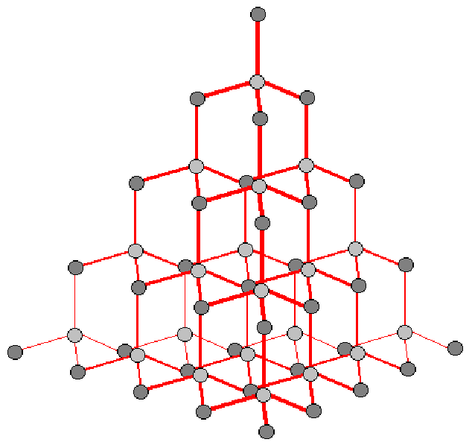
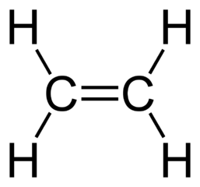
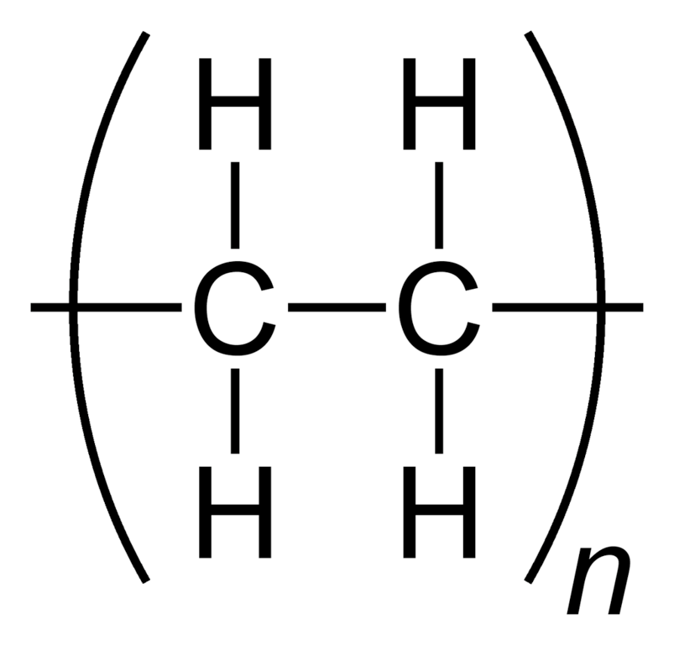
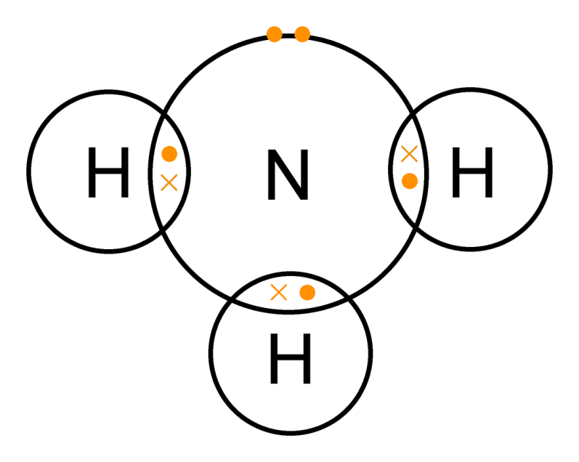
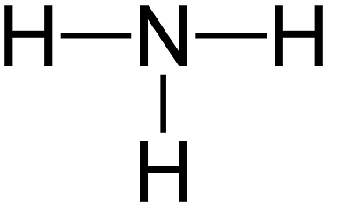
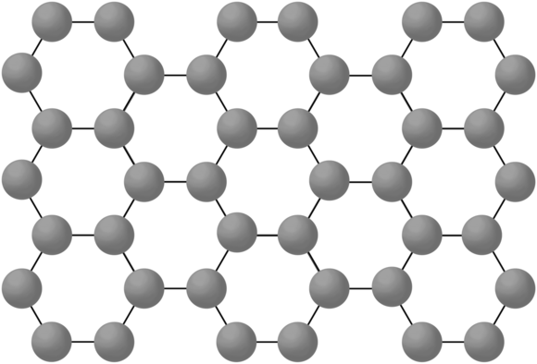
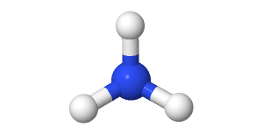
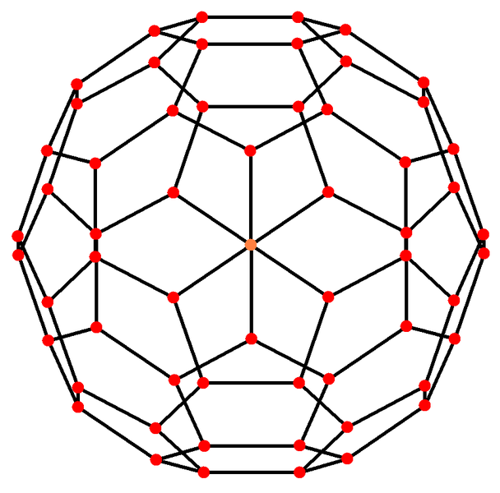
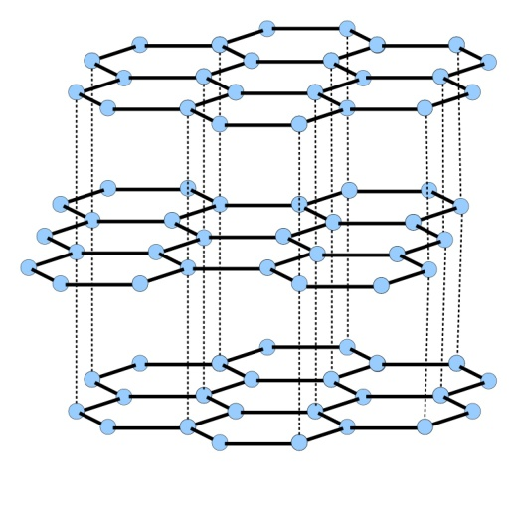
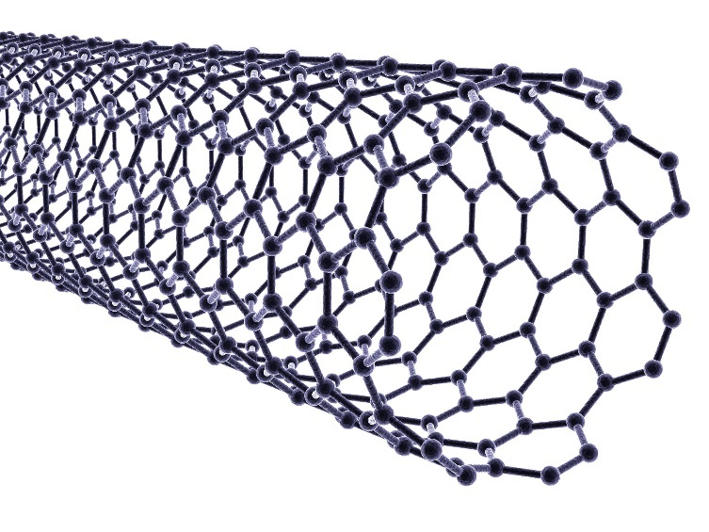
Each carbon atom is bonded to four others |  | Very hard. | Rigid structure.
 |  | Very high melting point. | Strong covalent bonds.
 |  | Does not conduct electricity. | No delocalised electrons.
Very large molecules | Solids at room temperature | Atoms are linked by strong covalent bonds.
Usually gases or liquids | Covalent bonds in the molecule are strong but forces between molecules (intermolecular) are weak | Low melting and boiling points. | Due to having weak intermolecular forces that easily broken.
 |  | Do not conduct electricity. | Due to them molecules not having an overall electrical charge.
 |  | Larger molecules have higher melting and boiling points. | Intermolecular forces increase with the size of the molecules.
Polymers
Diamond
Diamond, graphite, silicon dioxide | Very high melting points | Lots of energy needed to break strong, covalent bonds.
Giant covalent structures
AQA
BONDING, STRUCTURE AND THE PROPERTIES OF MATTER 2
Atoms share pairs of electrons | Can be small molecules e.g. ammonia
 | Can be giant covalent structures e.g. polymers
Properties of small molecules
Dot and cross :
+ Show which atom the
electrons in the bonds come
from
- All electrons are identical
Covalent bonding
Size of particles and their properties (Chemistry only)
2D with bonds:
+ Show which atoms are bonded together
- It shows the H-C-H bond
incorrectly at 90°
Graphene | Single layer of graphite one atom thick | Excellent conductor. | Contains delocalised electrons.
 |  | Very strong. | Contains strong covalent bonds.
Nanoparticles | Between 1 and 100 nanometres (nm) in size | 1 nanometre (1 nm) = 1 x 10⁻⁹ metres (0.000 000 001m or a billionth of a metre).
Graphene and fullerenes
3D ball and stick model:
+ Attempts to show the H-C-H bond angle is 109.5°
Use of nanoparticles
Healthcare, cosmetics, sun cream, catalysts, deodorants, electronics. | Nanoparticles may be toxic to people. They may be able to enter the brain from the bloodstream and cause harm.
Fullerenes |  | Buckminsterfullerene, C₆₀ First fullerene to be discovered. | Hexagonal rings of carbon atoms with hollow shapes. Can also have rings of five (pentagonal) or seven (heptagonal) carbon atoms.
Graphite
Each carbon atom is bonded to three others forming layers of hexagonal rings with no covalent bonds between the layers |  | Slippery. | Layers can slide over each other.
 |  | Very high melting point. | Strong covalent bonds.
 |  | Does conduct electricity. | Delocalised electrons between layers.
Carbon nanotubes |  | Very thin and long cylindrical fullerenes | Very conductive. | Used in electronics industry.
 |  |  | High tensile strength. | Reinforcing composite materials.
 |  |  | Large surface area to volume ratio. | Catalysts and lubricants.

Slide 5
M_{r} | The sum of the relative atomic masses of the atoms in the numbers shown in the formula | The sum of the M_{r} of the reactants in the quantities shown equals the sum of the M_{r} of the products in the quantities shown. | 2Mg + O₂ → 2MgO 48g + 32g = 80g 80g = 80g
The reactant that is completely used up | Limits the amount of product that is made | Less moles of product are made.
Whenever a measurement is taken, there is always some uncertainty about the result obtained | Can determine whether the mean value falls within the range of uncertainty of the result | Calculate the mean Calculate the range of the results Estimate of uncertainty in mean would be half the range
Mass appears to increase during a reaction | One of the reactants is a gas | Magnesium + oxygen → magnesium oxide
Mass appears to decrease during a reaction | One of the products is a gas and has escaped | Calcium carbonate → carbon dioxide + calcium oxide
Limiting reactants
(HT only)
Relative formula mass (M_{r})
Chemical measurements
Concentration of solutions
Example: Mean value is 46.5s Range of results is 44s to 49s = 5s Time taken was 46.5s $±$2.5s
Mass changes when a reactant or product is a gas
Conservation of mass | No atoms are lost or made during a chemical reaction | Mass of the products equals the mass of the reactants.
AQA GCSE
QUANTITATIVE CHEMISTRY 1
Measured in mass per given volume of solution (g/dm³) | Conc. = mass (g) . volume (dm³) | HT only Greater mass = higher concentration. Greater volume = lower concentration.
Balanced symbol equations | Represent chemical reactions and have the same number of atoms of each element on both sides of the equation | H₂ + Cl₂ → 2HCl Subscript numbers show the number of atoms of the element to its left. Normal script numbers show the number of molecules.
Amounts of substances in equations (HT only)
Subscript Normal script
Conservation of mass and balanced symbol equations
Using moles to balance equations (HT only)
The balancing numbers in a symbol equation can be calculated from the masses of reactants and products | Convert the masses in grams to amounts in moles and convert the number of moles to simple whole number ratios.
Moles (HT only)
Chemical amounts are measured in moles (mol) | Mass of one mole of a substance in grams = relative formula mass | One mole of H₂O = 18g (1 + 1 + 16) One mole of Mg = 24g
Chemical equations show the number of moles reacting and the number of moles made | Mg + 2HCl → MgCl₂ + H₂ One mole of magnesium reacts with two moles of hydrochloric acid to make one mole of magnesium chloride and one mole of hydrogen | If you have a 60g of Mg, what mass of HCl do you need to convert it to MgCl₂? A_{r} : Mg =24 so mass of 1 mole of Mg = 24g M_{r} : HCl (1 + 35.5) so mass of 1 mole of HCl = 36.5g So 60g of Mg is 60/24 = 2.5 moles Balanced symbol equation tells us that for every one mole of Mg, you need two moles of HCl to react with it. So you need 2.5x2 = 5 moles of HCl You will need 5 x 36.5g of HCl= 182.5g
Avogadro constant | One mole of any substance will contain the same number of particles, atoms, molecules or ions. | 6.02 x 10²³ per mole One mole of H₂O will contain 6.02 x 10²³ molecules One mole of NaCl will contain 6.02 x 10²³ Na⁺ ions
Number of moles = mass (g) or mass (g) A_{r} M_{r} | How many moles of sulfuric acid molecules are there in 4.7g of sulfuric acid (H₂SO₄)? Give your answer to 1 significant figure. 4.7 = 0.05 mol 98 (M_{r} of H₂SO₄)

Slide 6
A measure of the amount of starting materials that end up as useful products | Atom economy = Relative formula mass of desired product from equation x 100 Sum of relative formula mass of all reactants from equation | High atom economy is important or sustainable development and economic reasons
Calculate the atom economy for making hydrogen by reacting zinc with hydrochloric acid: Zn + 2HCl → ZnCl₂ + H₂ M_{r} of H₂ = 1 + 1 = 2 M_{r} of Zn + 2HCl = 65 + 1 + 1 + 35.5 + 35.5 = 138 Atom economy = ²∕₁₃₈ × 100 = ²∕₁₃₈ × 100 = 1.45% This method is unlikely to be chosen as it has a low atom economy.
Concentration of a solution is the amount of solute per volume of solution | Concentration = amount (mol) (mol/dm³) volume (dm³) | What is the concentration of a solution that has 35.0g of solute in 0.5dm³ of solution? 35/0.5 = 70 g/dm³
Using concentrations of solutions in mol/dm³
(HT only, chemistry only)
Titration | If the volumes of two solutions that react completely are known and the concentrations of one solution is known, the concentration of the other solution can be calculated. | 2NaOH(aq) + H₂SO₄(aq)→ Na₂S0₄(aq) + 2H₂O(l) It takes 12.20cm³ of sulfuric acid to neutralise 24.00cm³ of sodium hydroxide solution, which has a concentration of 0.50mol/dm³. Calculate the concentration of the sulfuric acid in mol/dm³: 0.5 mol/dm³ x (24/1000) dm³ = 0.012 mol of NaOH The equation shows that 2 mol of NaOH reacts with 1 mol of H₂SO₄, so the number of moles in 12.20cm³ of sulfuric acid is (0.012/2) = 0.006 mol of sulfuric acid Calculate the concentration of sulfuric acid in mol/ dm³ 0.006 mol x (1000/12.2) dm³ =0.49mol/dm³
Atom economy
AQA
QUANTITATIVE CHEMISTRY 2
HT only: 200g of calcium carbonate is heated. It decomposes to make calcium oxide and carbon dioxide. Calculate the theoretical mass of calcium oxide made. CaCO₃ → CaO + CO₂ M_{r} of CaCO₃ = 40 + 12 + (16x3) = 100 M_{r} of CaO = 40 + 16 = 56 100g of CaCO₃ would make 56 g of CaO So 200g would make 112g
Percentage yield
Use of amount of substance in relation to volumes of gases
(HT only, chemistry only)
Calculate the concentration of sulfuric acid in g/ dm³: H₂SO₄ = (2x1) + 32 + (4x16) = 98g 0.49 x 98g = 48.2g/dm³
Yield is the amount of product obtained | It is not always possible to obtain the calculated amount of a product | The reaction may not go to completion because it is reversible.
 |  | Some of the product may be lost when it is separated from the reaction mixture.
 |  | Some of the reactants may react in ways different to the expected reaction.
Equal amounts of moles or gases occupy the same volume under the same conditions of temperature and pressure | The volume of one mole of any gas at room temperature and pressure (20°C and 1 atmospheric pressure) is 24 dm³ | No. of moles of gas = vol of gas (dm³) 24dm³
Percentage yield is comparing the amount of product obtained as a percentage of the maximum theoretical amount | % Yield = Mass of product made x 100 Max. theoretical mass | A piece of sodium metal is heated in chlorine gas. A maximum theoretical mass of 10g for sodium chloride was calculated, but the actual yield was only 8g. Calculate the percentage yield. Percentage yield = 8/10 x 100 =80%
What is the volume of 11.6 g of butane (C₄H₁₀) gas at RTP? M_{r} : (4 x 12) + (10 x 1) = 58 11.6/58 = 0.20 mol Volume = 0.20 x 24 = 4.8 dm³
6g of a hydrocarbon gas had a volume of 4.8 dm³. Calculate its molecular mass. 1 mole = 24 dm³, so 4.8/24 = 0.2 mol M_{r} = 6 / 0.2 = 30 If 6g = 0.2 mol, 1 mol equals 30 g

Slide 7
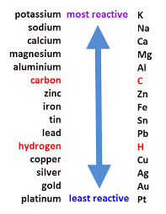
Oxidation Is Loss (of electrons) Reduction Is Gain (of electrons)
HT ONLY: Reactions between metals and acids are redox reactions as the metal donates electrons to the hydrogen ions. This displaces hydrogen as a gas while the metal ions are left in the solution.
Ionic half equations (HT only)
For displacement reactions | Ionic half equations show what happens to each of the reactants during reactions | For example: The ionic equation for the reaction between iron and copper (II) ions is: Fe + Cu²⁺ → Fe²⁺ + Cu The half-equation for iron (II) is: Fe → Fe²⁺ + 2e⁻ The half-equation for copper (II) ions is: Cu²⁺ + 2e⁻ → Cu
Reactions with acids | metal + acid → metal salt + hydrogen | magnesium + hydrochloric acid → magnesium chloride + hydrogen zinc + sulfuric acid → zinc sulfate + hydrogen
Acids react with some metals to produce salts and hydrogen.
Extraction using carbon
Metals less reactive than carbon can be extracted from their oxides by reduction. | For example: zinc oxide + carbon → zinc + carbon dioxide
Reactions of acids and metals
Reactions of acids
Acid name | Salt name
Hydrochloric acid | Chloride
Sulfuric acid | Sulfate
Nitric acid | Nitrate
Oxidation and reduction in terms of electrons (HT ONLY)
Extraction of metals and reduction
Unreactive metals, such as gold, are found in the Earth as the metal itself. They can be mined from the ground.
AQA Chemical Changes 1
 | Reactions with water | Reactions with acid
Group 1 metals | Reactions get more vigorous as you go down the group | Reactions get more vigorous as you go down the group
Group 2 metals | Do not react with water | Observable reactions include fizzing and temperature increases
Zinc, iron and copper | Do not react with water | Zinc and iron react slowly with acid. Copper does not react with acid.
Neutralisation of acids and salt production
Reactivity of metals
sodium hydroxide + hydrochloric acid → sodium chloride + water
calcium carbonate + sulfuric acid → calcium sulfate, + carbon dioxide + water
The reactivity series
Neutralisation | Acids can be neutralised by alkalis and bases | An alkali is a soluble base e.g. metal hydroxide. A base is a substance that neutralises an acid e.g. a soluble metal hydroxide or a metal oxide.
Metal oxides
Metals form positive ions when they react | The reactivity of a metal is related to its tendency to form positive ions | The reactivity series arranges metals in order of their reactivity (their tendency to form positive ions).
Carbon and hydrogen | Carbon and hydrogen are non-metals but are included in the reactivity series | These two non-metals are included in the reactivity series as they can be used to extract some metals from their ores, depending on their reactivity.
Displacement | A more reactive metal can displace a less reactive metal from a compound. | Silver nitrate + Sodium chloride → Sodium nitrate + Silver chloride
Metals and oxygen | Metals react with oxygen to form metal oxides | magnesium + oxygen → magnesium oxide 2Mg + O₂ → 2MgO
Reduction | This is when oxygen is removed from a compound during a reaction | e.g. metal oxides reacting with hydrogen, extracting low reactivity metals
Oxidation | This is when oxygen is gained by a compound during a reaction | e.g. metals reacting with oxygen, rusting of iron

Slide 8
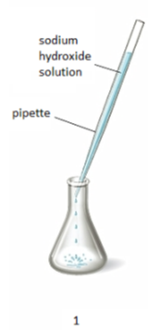
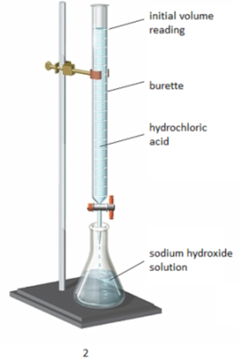
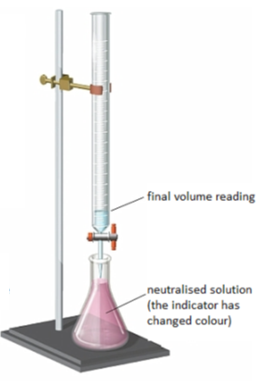
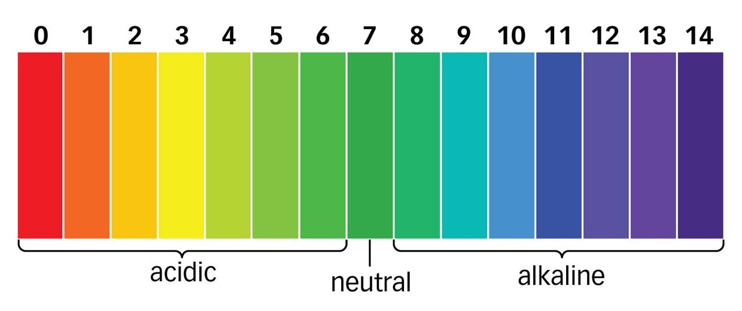
The ions discharged when an aqueous solution is electrolysed using inert electrodes depend on the relative reactivity of the elements involved.
Process of electrolysis | Splitting up using electricity | When an ionic compound is melted or dissolved in water, the ions are free to move. These are then able to conduct electricity and are called electrolytes. Passing an electric current though electrolytes causes the ions to move to the electrodes.
Electrode | Anode Cathode | The positive electrode is called the anode. The negative electrode is called the cathode.
Where do the ions go? | Cations Anions | Cations are positive ions and they move to the negative cathode. Anions are negative ions and they move to the positive anode.
Extracting metals using electrolysis | Metals can be extracted from molten compounds using electrolysis.
 | This process is used when the metal is too reactive to be extracted by reduction with carbon.
 | The process is expensive due to large amounts of energy needed to produce the electrical current. Example: aluminium is extracted in this way.
At the negative electrode | Metal will be produced on the electrode if it is less reactive than hydrogen. Hydrogen will be produced if the metal is more reactive than hydrogen.
At the positive electrode | Oxygen is formed at positive electrode. If you have a halide ion (Cl⁻, I⁻, Br⁻) then you will get chlorine, bromine or iodine formed at that electrode.
Electrolysis of aqueous solutions
Electrolysis
Higher tier: You can display what is happening at each electrode using half-equations:
At the cathode: Pb²⁺ + 2e⁻ → Pb
At the anode: 2Br⁻ → Br₂ + 2e⁻
Strong acids | Completely ionised in aqueous solutions e.g. hydrochloric, nitric and sulfuric acids.
Weak acids | Only partially ionised in aqueous solutions e.g. ethanoic acid, citric acid.
Hydrogen ion concentration | As the pH decreases by one unit (becoming a stronger acid), the hydrogen ion concentration increases by a factor of 10.
AQA Chemical Changes 2
Strong and weak acids (HT ONLY)
Reactions of acids
 | 1. Use the pipette to add 25 cm³ of alkali to a conical flask and add a few drops of indicator.
 | 2. Fill the burette with acid and note the starting volume. Slowly add the acid from the burette to the alkali in the conical flask, swirling to mix.
 | 3. Stop adding the acid when the end-point is reached (the appropriate colour change in the indicator happens). Note the final volume reading. Repeat steps 1 to 3 until you get consistent readings.
Titrations (Chemistry only)
Soluble salts | Soluble salts can be made from reacting acids with solid insoluble substances (e.g. metals, metal oxides, hydroxides and carbonates).
Production of soluble salts | Add the solid to the acid until no more dissolves. Filter off excess solid and then crystallise to produce solid salts.
Titrations are used to work out the precise volumes of acid and alkali solutions that react with each other.
Soluble salts
Calculating the chemical quantities in titrations involving concentrations in mol/dm³ and in g/dm³ (HT ONLY): 2NaOH(aq) + H₂SO₄(aq)→ Na₂S0₄(aq) + 2H₂O(l) It takes 12.20cm³ of sulfuric acid to neutralise 24.00cm³ of sodium hydroxide solution, which has a concentration of 0.50mol/dm³. Calculate the concentration of the sulfuric acid in g/dm³ 0.5 mol/dm³ x (24/1000) dm³ = 0.012 mol of NaOH | The equation shows that 2 mol of NaOH reacts with 1 mol of H₂SO₄, so the number of moles in 12.20cm³ of sulfuric acid is (0.012/2) = 0.006 mol of sulfuric acid Calculate the concentration of sulfuric acid in mol/ dm³ 0.006 mol x (1000/12.2) dm³ =0.49mol/dm³ Calculate the concentration of sulfuric acid in g/ dm³ H₂SO₄ = (2x1) + 32 + (4x16) = 98g 0.49 x 98g = 48.2g/dm³
You can use universal indicator or a pH probe to measure the acidity or alkalinity of a solution against the pH scale.
The pH scale and neutralisation
Acids | Acids produce hydrogen ions (H⁺) in aqueous solutions.
Alkalis | Aqueous solutions of alkalis contain hydroxide ions (OH⁻).
In neutralisation reactions, hydrogen ions react with hydroxide ions to produce water:
H⁺ + OH⁻ → H₂O

