Slide 1



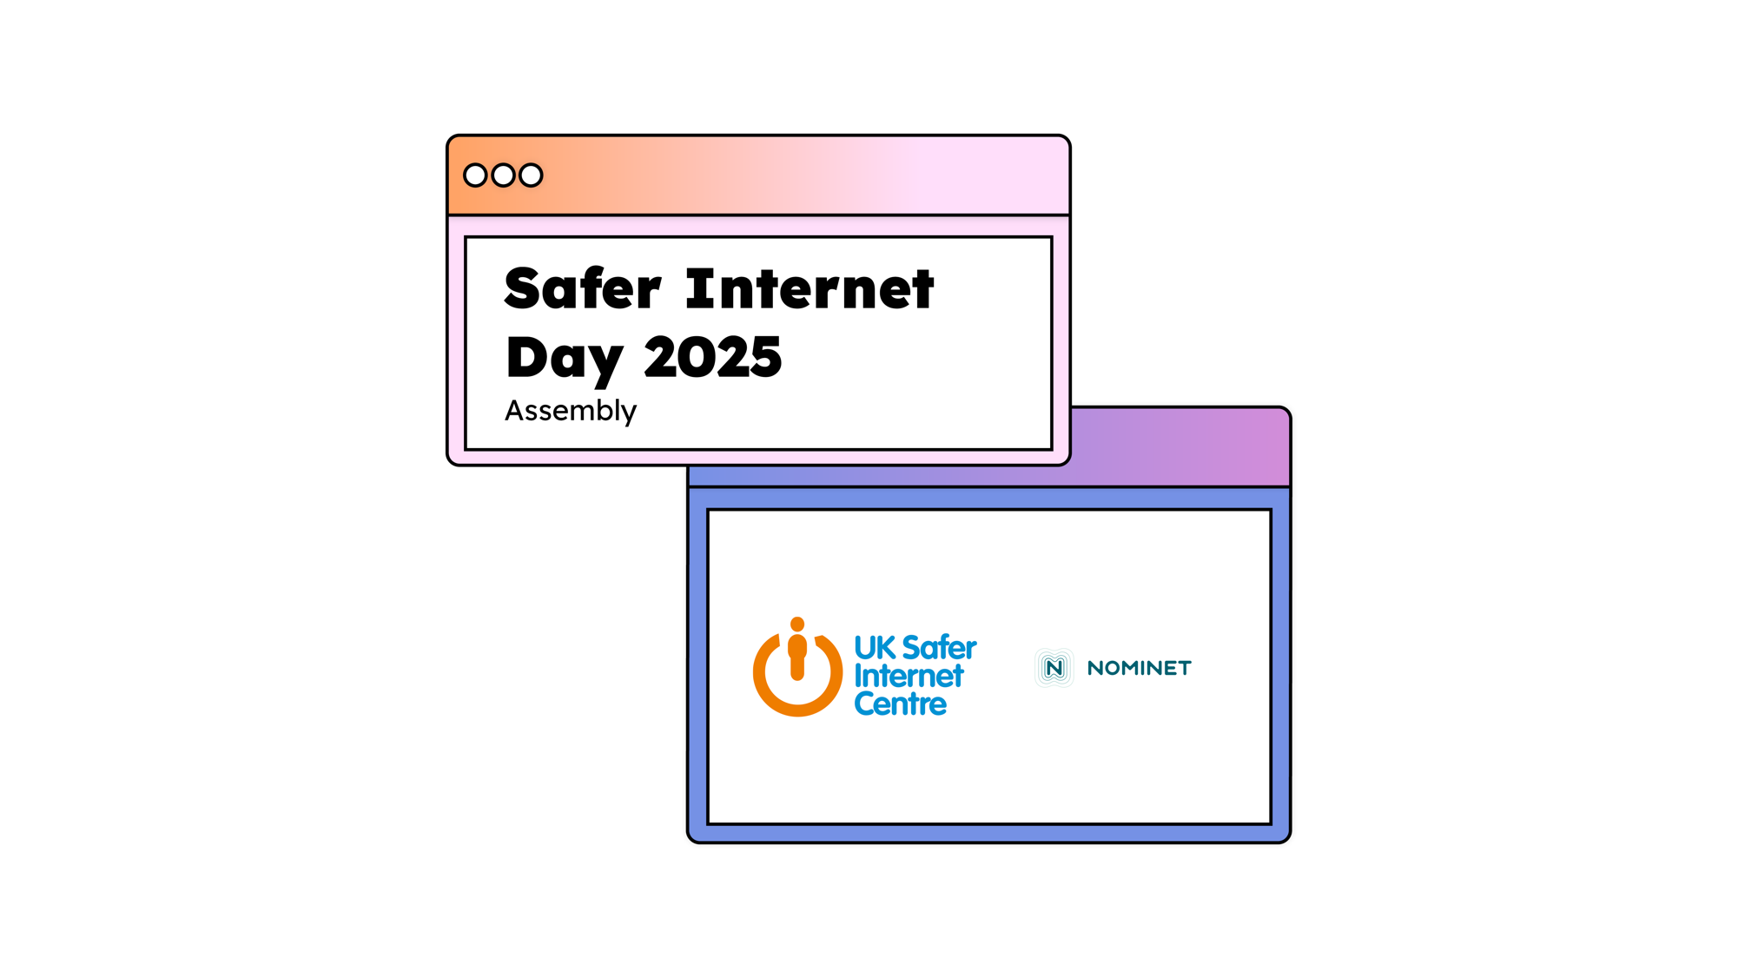
Miss Alston
Online Safety Lead
February 2025.
Notes:
Hello, everyone. In today’s assembly, we’re going to be talking about Safer Internet Day.

Slide 2


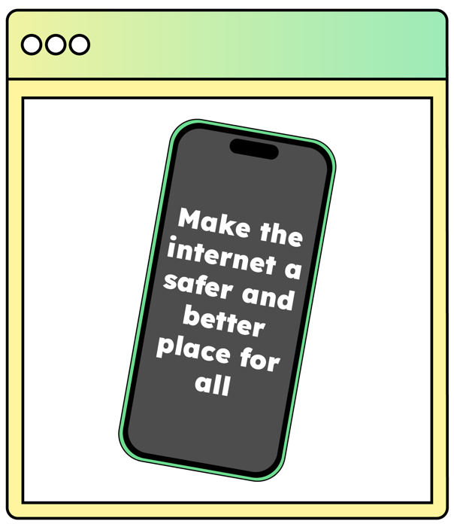


Notes:
Safer Internet Day is held every February in over 170 different countries. The goal of Safer Internet Day is to call on people across the world to work together to make the internet a safer and better place for all, but especially for young people. In the UK, the UK Safer Internet Centre runs a campaign especially for the day which aims to start a national conversation about using technology safely and positively. Last year over half of children and young people in the UK heard about the campaign, but it also involves government, charities, police forces and tech companies including social media and gaming platforms.

Slide 3



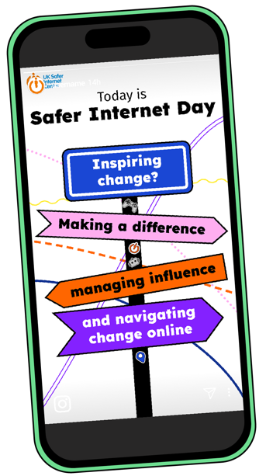
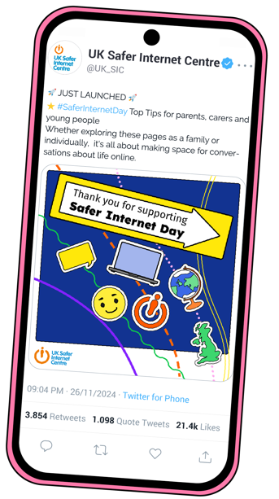
Notes:
In fact, in 2024, over 2,000 organisations across the UK delivered activities for the day. It was profiled on national TV and radio, including the BBC. Young people met with Government Ministers and other organisations including children’s charities and representatives from the tech industry in London. Millions more people engaged with the day online: we saw people across the UK sharing their celebrations on social media, and over 20,000 young people tested their online safety knowledge with online quizzes. By being part of this assembly, you’re joining countless others in making Safer Internet Day 2025 the biggest yet!

Slide 4




Notes:
This year Safer Internet Day is focusing on online scams. Picture the victim of an online scam. Who are they?
[If appropriate to do so, take responses from learners.]

Slide 5

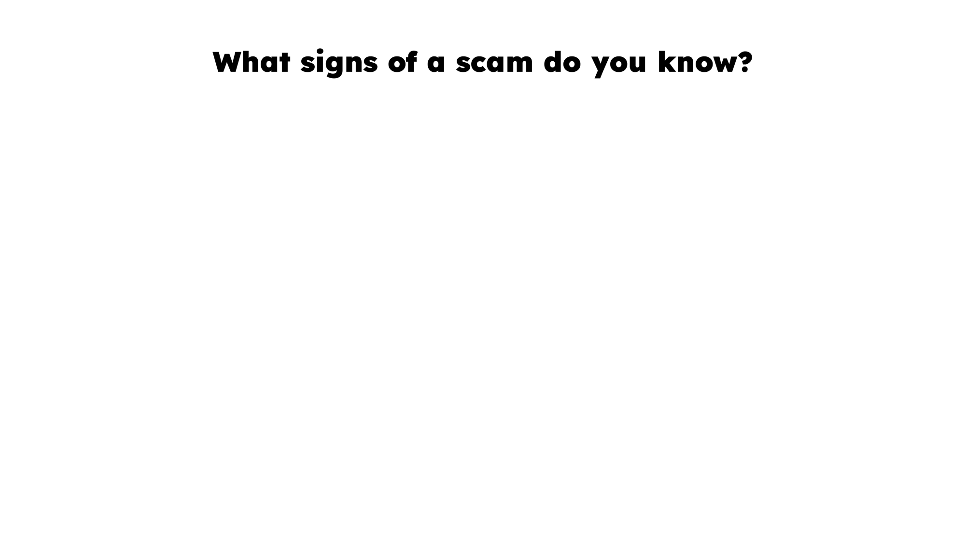












Notes:
Whatever you may think, anyone can be a victim of fraud or online scams and scammers often operate on a huge scale, messaging thousands of potential victims in the hopes that just one will respond. Scammers also use many different sophisticated tactics to target their victims and steal personal information or money. What signs of a scam do you know?
[Take responses]
Scammers will often use psychological tactics, like promising you something that might otherwise be hard to get. Hard to find tickets or an amazing deal might seem too good to be true, but scammers hope their victims won’t risk missing out. Another tactic might be pressuring victims to make a decision quickly, for example by claiming a deal is only around for a limited time. You also might spot scammers pretending to be someone trustworthy, even using a famous person’s name, photo or fake video of them, or using official logos to look more believable. A scammer may pretend that a person has missed a payment and that they need to pay a fine immediately, or they will get into trouble.
Scammers are also quick to use our emotions against us, sometimes using fear, guilt or even love to pressure victims into making decisions without thinking them through
Ultimately, if you’re contacted out of the blue or someone is asking you for money, especially via bank transfer, or if they want to borrow your bank account or email address, or if they ask you for some of your personal information, including pin numbers, passwords, or one-time security codes, there’s a good chance you’re being targeted by a scammer.
Scammers are also quick to use our emotions against us, sometimes using fear, guilt, or even love to pressure victims into making decisions without thinking them through
Ultimately, if you’re contacted out of the blue or someone is asking you for money, especially via bank transfer or to share personal information, including pin numbers, passwords, or one-time security codes, there’s a good chance you’re being targeted by a scammer.

Slide 6






Notes:
If you or somebody else is tricked by a scam online, it is never your fault. Whilst some scams may seem easy to spot, scammers are good at what they do and use different methods to target people and make them more vulnerable. Let’s look at some examples…
[Click to reveal and read each scam type as they appear]
Phishing
This is when scammers pretend to be a well-known organisation or company, in order to get your personal information or bank details. They might come in the form of messages or emails with suspicious content or links.
Online shopping scams
Some criminals will use the internet, especially auction sites and apps, or social media, to sell items like counterfeit designer clothes or fake tickets. Often the products they claim to be selling don’t even exist.
Impersonation
Similar to phishing, the scammer will pretend to be someone else. This could be a friend or family member, a celebrity or online personality, or even a representative of an official organisation like HMRC (who are responsible for taxes) or the police.
Romance scams
Romance scammers target their victims by building up a romantic relationship with them online, before trying to steal from them or manipulate them further.
Money muling
Money gained from fraud and theft needs to be kept somewhere. To help move it around, criminals will recruit people to hold and transfer money on their behalf, often receiving a percentage of that money in return. Sometimes known as ‘money mules’, this can seem like a quick and easy way to make some money but remember it is a crime.

Slide 7




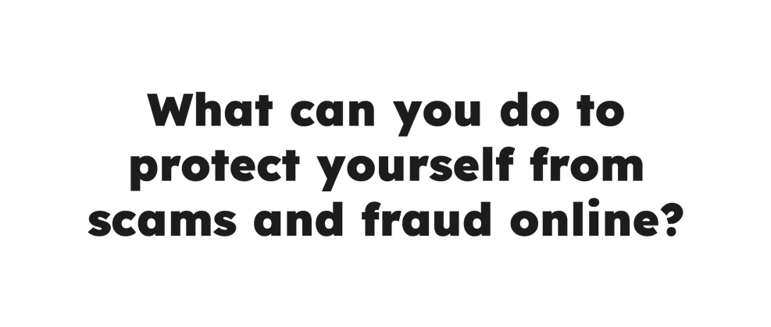

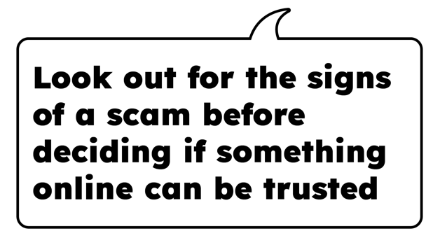

Notes:
So, let’s think about how we can protect ourselves from online scams. Turn to the person next to you and discuss:
What can you do to protect yourself from scams and fraud online?
You might be thinking of:
[Click to reveal answers.]
Using strong and separate passwords for different online accounts. If you use the same password for lots of different accounts, this makes them a lot more vulnerable to scammers. A strong password won’t use any personal information, will be a combination of letters, numbers and symbols and will be difficult for someone to guess. Advice from the National Cyber Security Centre suggests using three random words. You can save passwords in your browser or use a password manager.
Using 2-step verification to protect important accounts. This setting means you prove your identity with a pin or passcode when you sign in on a new device or change important account settings. Nobody (not even the bank) should ask you to tell them your password or your 2-step verification code.
Making online purchases through official retailers or on apps with buyer protection, and never via bank transfer.
Looking out for the signs of a scam online.
Checking the privacy and security settings on the apps and games you use. You want to reduce how much personal information fraudsters can find out about you online and reduce their ability to contact you or hack into your accounts.
Talking to a trusted adult if you’re not sure whether something online can be trusted.

Slide 8

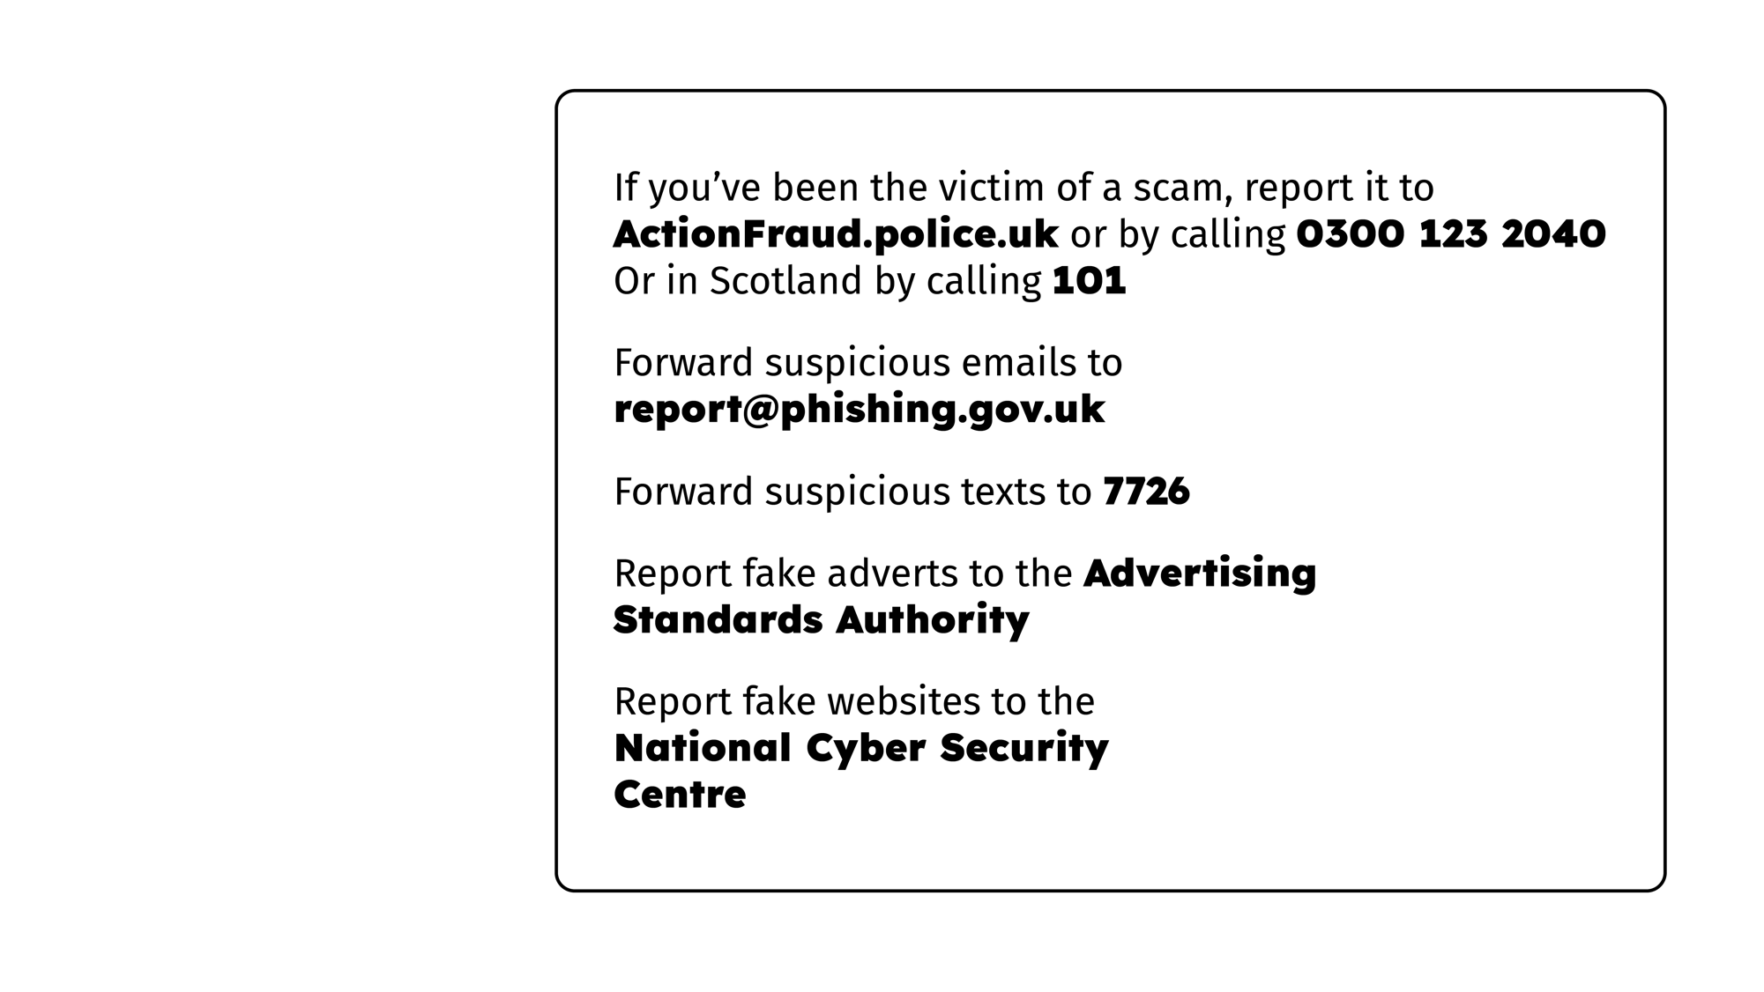

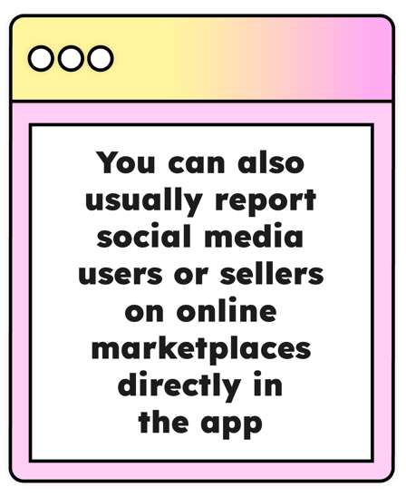
Notes:
Of course, it’s also important to know how to respond if you’ve seen or been the victim of a scam. As well as speaking to a trusted adult, the best thing to do is often to make a report.
In England, Wales and Northern Ireland, if you’ve been scammed you can report it to ActionFraud online or by calling 0300 123 2040.
In Scotland, fraud can be reported to Police Scotland by calling 101.
If you’ve received a suspicious email, you can forward it to report@phishing.gov.uk
To report a suspicious text, forward it to 7726 and, to report a call, use the same number but text the word ‘Call’ and the number the call was from.
Suspicious or fake websites can be reported online to the National Cyber Security Centre, and fake adverts can be reported online to the Advertising Standards Authority.
If you’ve spotted a scam on social media or an online marketplace, you can also report it directly via the app.
Don’t forget to check your privacy and security settings and change any passwords you think may have been compromised.

Slide 9


Tutors
Teachers
Heads of House
Learning Mentors
Learning Support Assistants
Any trusted adult!
Notes:
Here at [name of school/setting] we want to make sure you are safe, in all parts of your life, including online. If something you’ve seen online or something that happened online is worrying you or affecting you, please come to us for help and advice. We’ll listen carefully and work with you to decide what the best thing to do next might be.

Slide 10


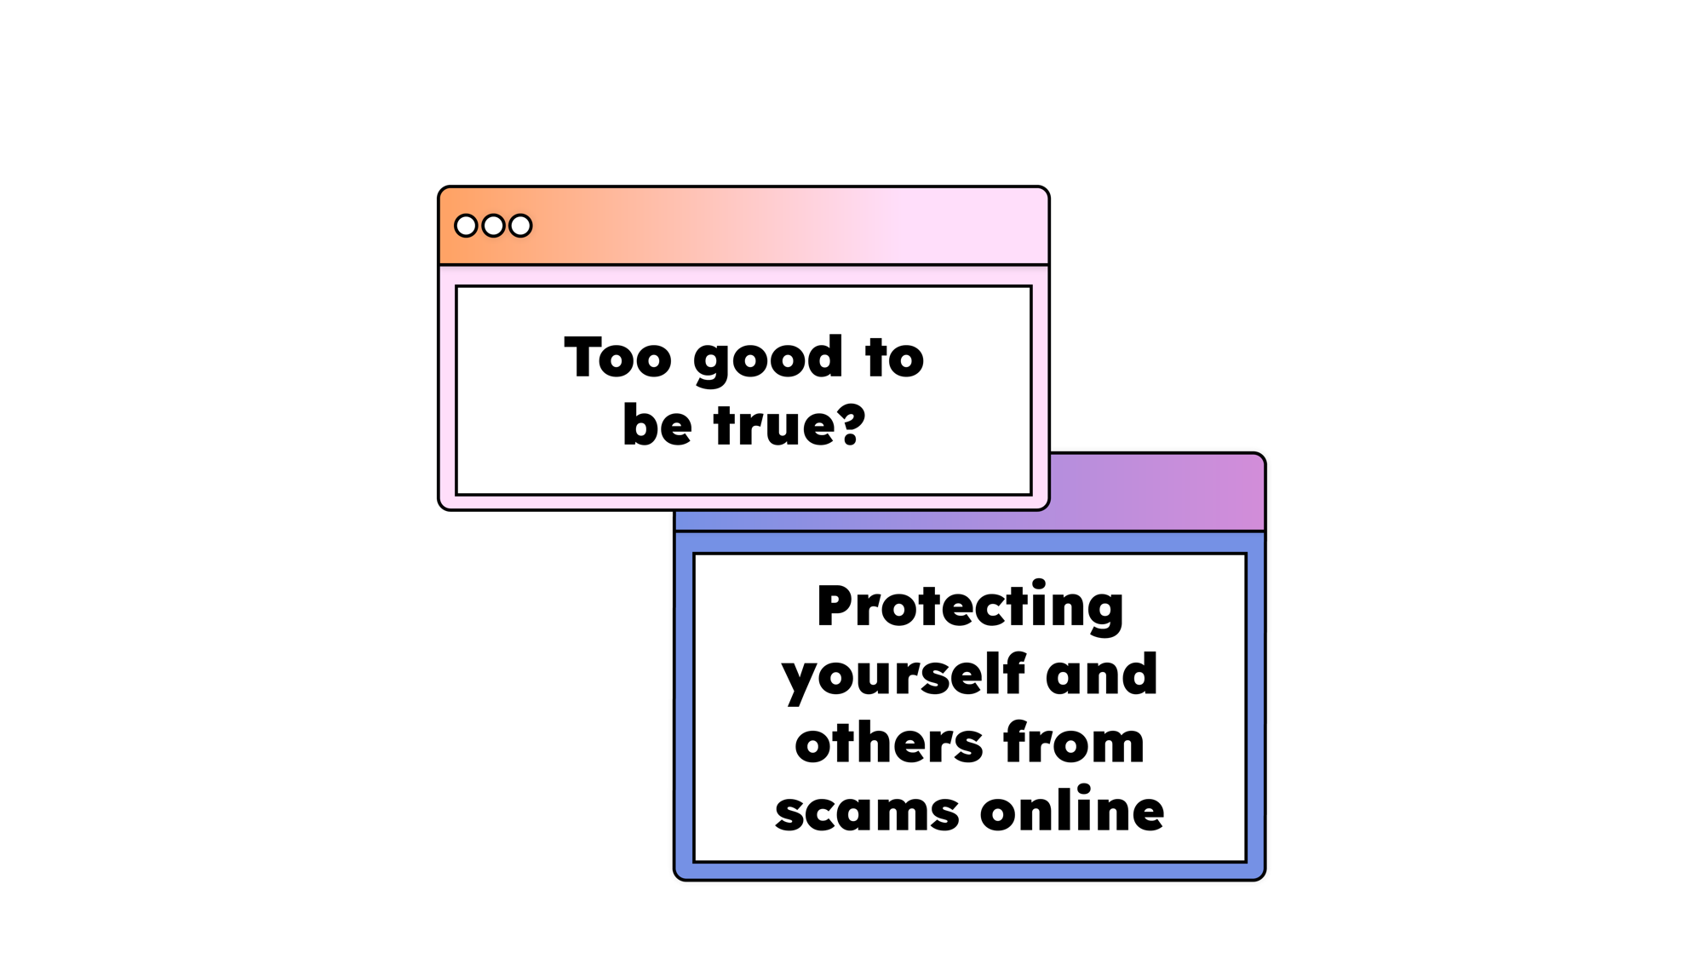

Notes:
As we come to the end of this assembly, we’ve looked at how criminals target people online and some of the things we can do to keep ourselves safe. But Safer Internet Day is also about starting a conversation and spreading the word. Anyone can be the victim of a scam and you can help others – like your parents or grandparents stay safe from scams online too.
So let’s work together to prevent scammers from harming the people we know and love, and protect ourselves from scams too.

